Slide 1
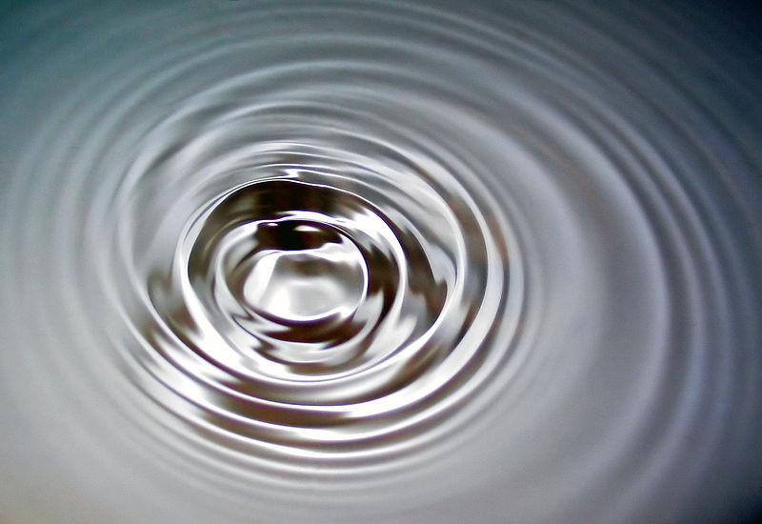
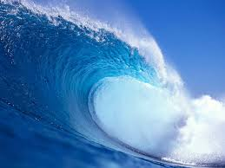
Engineering & Waves: Seismic Waves

Slide 2
Engineering Waves Overview
In this lesson, we will learn about:
What are waves?
What are different types of waves?
How do waves travel?
How do waves relate to engineering?
Our focus is on:
Seismic waves

Slide 3
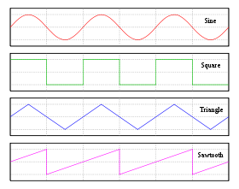
Wave Basics
What is a wave?
A disturbance that travels through space or time, usually by the transfer of energy
Many different types of waves
Notes:
One definition of a wave is a disturbance that travels through space or time, usually by the transfer of energy. There are many different types of waves. These illustrations show sine waves, as well as a few different types of waves that can be created by combining sine waves. Sine waves are one of the most familiar types of waves. Ocean waves move like sine waves.
http://commons.wikimedia.org/wiki/File:Simple_harmonic_motion_animation.gif

Slide 4
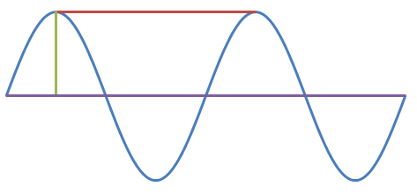
Wave Basics
Important vocabulary:
wavelength
amplitude
crest (ridge)
trough
frequency
wavelength
crest
amplitude
trough
Notes:
wavelength: The length of each wave cycle; the distance between one crest and the next crest.
amplitude: In the diagram of a sine wave, this can be seen as the height measured from the center or rest position.
crest: For a sine wave, the crest is the highest point in each wave cycle.
trough: The lowest point in each wave cycle.
frequency: The number of wave cycles in a given amount of time. Frequency is commonly measured in hertz (Hz) which tells how many waves occur in 1 second.
It is important to understand that wavelength and frequency have a relationship. When a wave has a really long wavelength, the frequency will be really low. When a wave has a really short wavelength, the frequency will be really high. Why do you think that is?

Slide 5
Types of Waves
electromagnetic waves
light waves
radio waves
sound waves
ocean waves
seismic waves
standing waves
⬆ In this animation of a standing wave, the red dots represent the nodes
Notes:
Some examples of waves include light waves, sound waves, ocean waves, seismic waves, pressure waves, compression waves, and standing waves. An animation of a standing wave is provided. The nodes on the standing wave are locations where there is no movement. Standing waves can be created by sending two sine waves with the same frequency and amplitude in opposite directions down a string. For example, you could create standing waves by holding one end of a jump rope and having a friend hold the other end and shaking the jump rope up and down with the same frequency and amplitude. The locations where the two waves cancel each other out are the nodes. Standing waves have important applications in musical instruments, such as guitars and violins.
http://commons.wikimedia.org/wiki/File:Standing_wave.gif

Slide 6
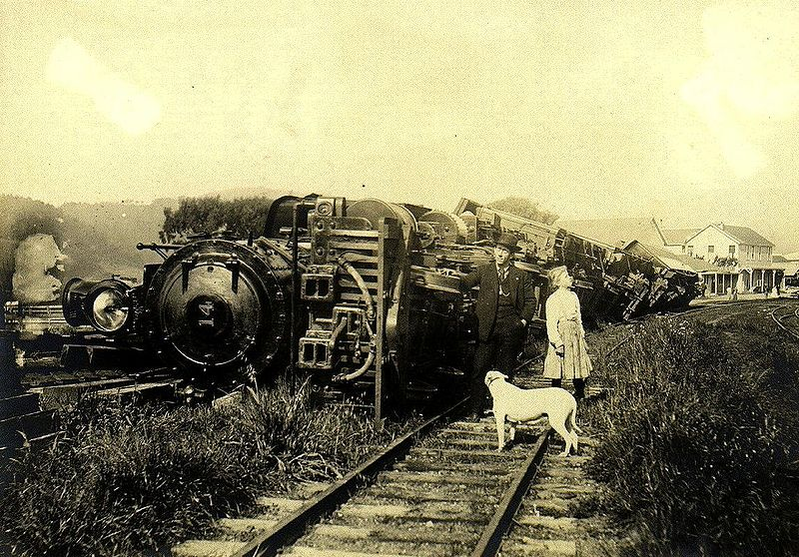
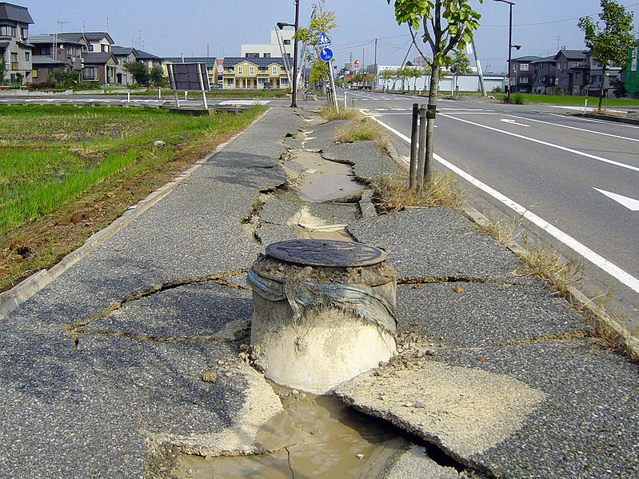
Engineering & Waves: Seismic Waves
Notes:
These two photographs show examples of the destruction caused by the seismic waves produced during an earthquake.
(left) This train was tipped over during the 1906 earthquake in northern California.
(right) During the 2004 earthquake in Chūetsu, Japan, these sewer pipes/manholes floated upward and the asphalt road cracked when the soil behaved like a liquid because of the stress of the sudden shaking movement (called soil liquifaction).

Slide 7
Why are engineers concerned about earthquakes?
Video
Notes:
Play this 48-second video called Earthquake Destruction to show clips taken during the 1989 northern California earthquake and after the 1999 Taiwan earthquake.
Source of Earthquake Destruction video: http://www.youtube.com/watch?v=4Y-62Ti5_6s&feature=fvst

Slide 8
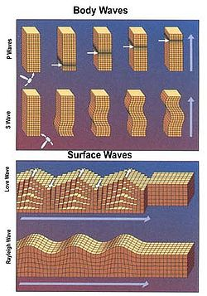
Seismic Waves
Waves that travel through the Earth
Classifications:
Body Waves
Faster, travel through the interior of the Earth
P-waves (primary)
S-waves (secondary)
Surface Waves
Slower, travel along the surface of the Earth
Cause more damage
Similar to water waves
Love waves
Rayleigh waves
Notes:
Seismic waves travel through the Earth, and are typically created by earthquakes. The two main categories of seismic waves are body waves and surface waves. Body waves travel through the body of the Earth and are faster than surface waves. The two types of body waves are P-waves (for primary) and S-waves (for secondary). Surface waves travel along the surface of the ground and are slower and more destructive than body waves. Love waves and Rayleigh waves are the two types of surface waves. The surface waves act similar to ocean waves in which the disturbance and movement can be seen along the surface.

Slide 9
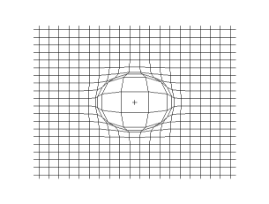
Body Waves: Primary Waves
P-waves cause the ground to have vibrations along or parallel to the direction of the wave
Fast! The first type of seismic wave to arrive at a point away from the epicenter
Can travel through any medium
Typical speeds:
In air: 330 m/s
In water: 1450 m/s
In granite: 5000 m/s
Plane P-wave
Propagation of a P-wave on a 2Dgrid
Notes:
P-waves (or primary waves) are the fastest of all seismic waves. P-waves move the Earth back and forth in the direction the wave is traveling. They can travel through any medium, meaning air, water or the Earth. Some typical speeds: 330 m/s (~738 mph) through air (a sound wave!), 1450 m/s (~3,244 mph) through water, and 5000 m/s (~11,185 mph) through granite.
http://commons.wikimedia.org/wiki/File:Onde_compression_impulsion_1d_30_petit.gif
http://commons.wikimedia.org/wiki/File:Ondes_compression_2d_20_petit.gif

Slide 10
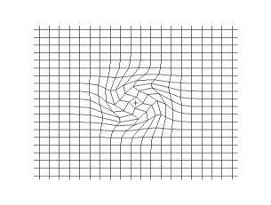
Body Waves: Secondary Waves
S-waves cause the motion of the ground to be perpendicular to the direction of the wave
Can only travel through solids
Speed is about 60% of a P-wave in a material
Arrives second at a point away from the epicenter
Plane S-wave
Propagation of a spherical S-wave on a 2D grid
Notes:
S-waves (or secondary waves) are another type of body wave, and as the name suggests, are the second fastest type of seismic wave, meaning an S-wave would be the second wave you would feel after an earthquake occurs. In fact, S-waves travel at 60% of the speed of P-waves. S-waves are similar to the sine waves we have seen; the displacement is perpendicular (or 90 degrees) to the movement of the wave. For example, if a wave was traveling to the right, the movement of the ground would be up and down. S-waves can only travel through solids.
http://commons.wikimedia.org/wiki/File:Onde_cisaillement_impulsion_1d_30_petit.gif
http://commons.wikimedia.org/wiki/File:Ondes_cisaillement_2d_20_petit.gif

Slide 11
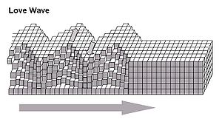
Surface Waves: Love Waves
Love waves cause horizontal shifting of the Earth during earthquakes
Move slower than P-waves and S-waves, but faster than Rayleigh waves
Named for A.E.H. Love, the man who predicted this type of seismic wave in 1911
Notes:
Love waves are one type of surface wave. Similar to S-waves, they are transverse waves, but instead of moving the Earth up and down, they move the surface of the ground back and forth perpendicular to the direction the wave is moving. They move slower than P- and S-waves, but faster than Rayleigh waves. These waves were named for A.E.H. Love, the man who predicted this type of seismic wave in 1911.

Slide 12
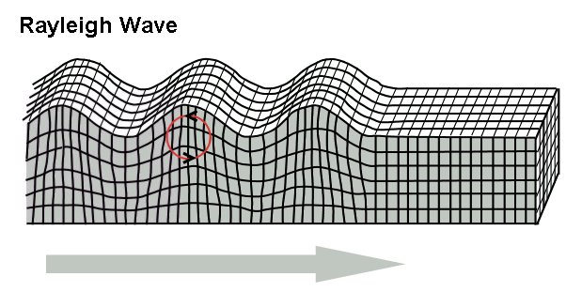
Surface Waves: Rayleigh Waves
Rayleigh waves cause a rolling motion—like ocean waves
Slowest of the seismic waves (travel at around 3 km/s)
Produced by the interaction of P- and S-waves at the Earth’s surface
Can be used to characterize the Earth’s interior and oil deposits
Notes:
Rayleigh waves are another type of surface wave. They cause a rolling motion along the surface of the ground, similar to the movement of ocean waves. They are the slowest of all the seismic waves and travel at speeds around 3 km/s (~ 6,711 mph). They are created by the interaction of the P- and S-waves, and therefore are indirectly caused by the actual earthquake. Scientists and engineers have studied Rayleigh waves as a way to characterize the interior of the Earth and to find oil deposits, because the speed and motion of Rayleigh waves are affected by what materials make up the ground they travel through.

Slide 13
All Seismic Waves
Intensity depends on:
Size of earthquake
Distance to the earthquake
Depth of the earthquake
Geological structure of the crust
The amplitude decreases with increasing depth of the earthquake and with distance traveled
Notes:
For all seismic waves, their intensity depends on the earthquake magnitude, the distance to the earthquake, the depth of the earthquake (how far underground of the epicenter does the earthquake occur), and the geological structure of the Earth (for example, clay, sand, granite, etc.)
The amplitude of the seismic waves are smaller if an earthquake occurs far underground. The closer to the surface of the Earth an earthquake occurs, the larger the amplitude. The amplitude also decreases the further the wave travels from the epicenter—this is why people in Colorado cannot feel an earthquake that takes place in California. The seismic waves get smaller and less destructive as they travel.

Slide 14
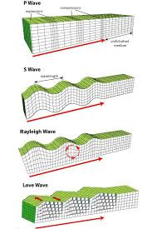
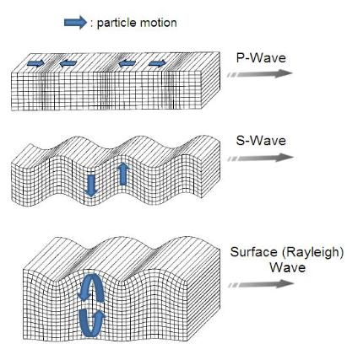
More information on Seismic Waves
Video
Notes:
A 2:50- minute video called Earthquake Waves, a NASA SciFi segment that explores the different types of waves that earthquakes create through the use of animations and a slinky.
Source of Earthquake Waves video: http://www.youtube.com/watch?v=sZPNjLj8hR8

Slide 15
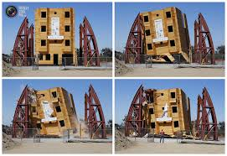
Engineering Design and Shake Tables
Clip
Notes:
Engineers design buildings, bridges and other infrastructure so they will be safe even during the extreme forces of earthquakes. To test their designs, engineers develop machines to re-enact (or simulate) the ground movement of seismic waves. To do this, engineers design shake tables that accurately reproduce the motions of the Earth caused by seismic waves. All this is done to provide people living in earthquake-prone areas with stable and survivable human-built environments.
This 2:51-minute video shows the largest shake table in the US designed to reproduce the movement generated by the seismic waves of the 1994 Northridge earthquake in Los Angeles, CA.
Source of Earthquake Shake Table Rocks Buildings video: http://www.youtube.com/watch?v=duzcOkzwpDo

Slide 16
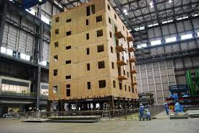
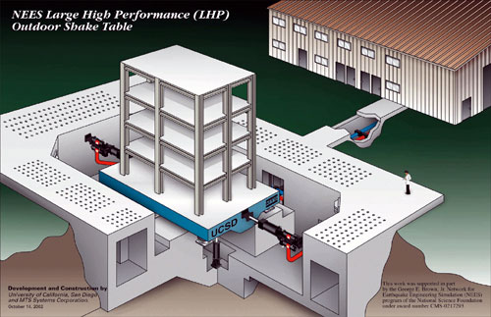
The World’s Largest Shake Table
Clip
Notes:
A 2:27-minute video shows the kind of amazing research being done to test earthquake-resistant construction using the world’s largest earthquake shake table, located in Japan. This video shows the simulation of a 7.5 magnitude earthquake on a seven-story building.
Engineers build shake tables, sometimes life-size (full-size) and sometimes small, model-size, to test the ability of buildings and other structures to withstand the forces of seismic waves generated by earthquakes. To do this, they design and create shake tables that can accurately re-enact the motions of the Earth during known (and seismically-recorded) earthquakes. All this is done to determine better building codes (rules) to make our structures survivable.
Source of World’s Largest Earthquake Shake Table in Japan video: http://www.youtube.com/watch?v=W4nLwwXhEag

