Slide 1
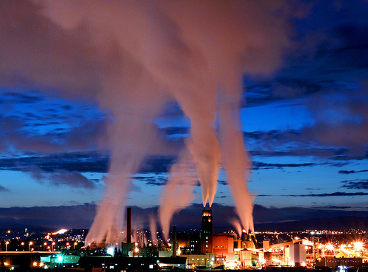
OBJECTIVE 3
HOW DOES HUMAN ACTIVITY ADVERSELY
AFFECT THE ATMOSPHERE?
ESSENTIAL QUESTION
EXPLAIN THE PRINCIPAL SOURCES,
COMPOSITION, AND EFFECTS OF
ATMOSPHERIC POLLUTION.

Slide 2
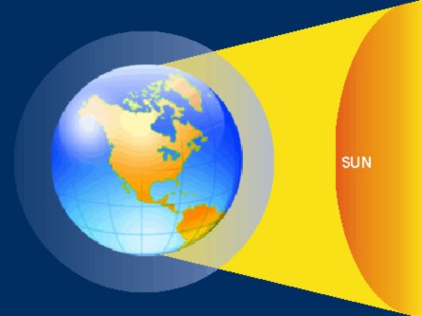
1.
EXPLAIN CFCs AND THEIR ROLE IN
STATOSPHERIC OZONE DEPLETION.

Slide 5
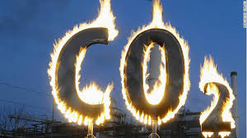
2.
EXPLAIN HOW CARBON DIOXIDE AND
METHANE ENHANCE THE GREENHOUSE
EFFECT, PREDICT THE POSSIBLE
CLIMATIC EFFECTS OF GLOBAL WARMING

Slide 6
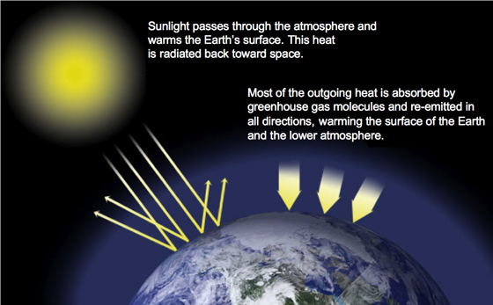

Slide 7
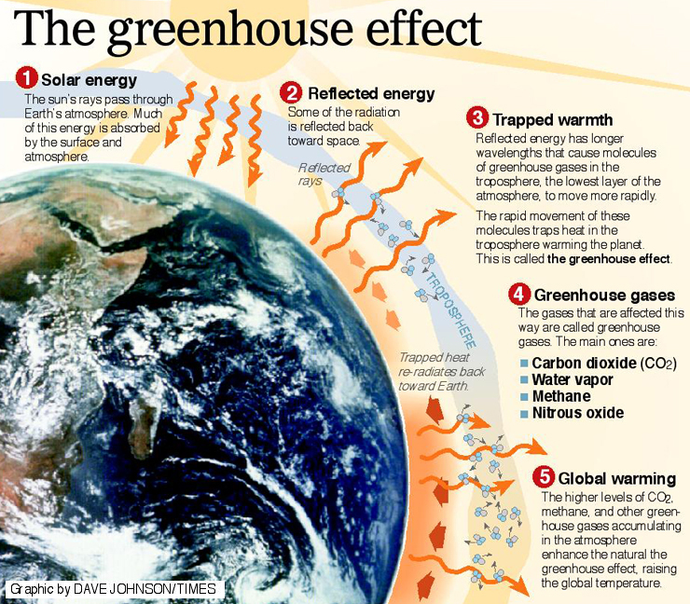

Slide 8
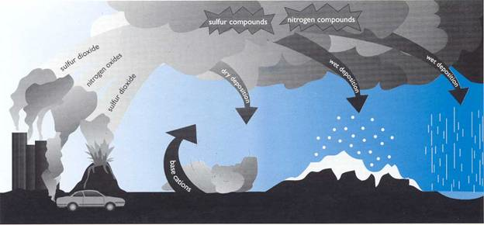
3.
EXPLAIN SULFUR DIOXIDE AND NITROGEN
COMPOUNDS AND THE FORMATION OF
ACID RAIN INCLUDING EFFECTS UPON
BUILDINGS, LAKES, RIVERS AND SOIL.

Slide 9
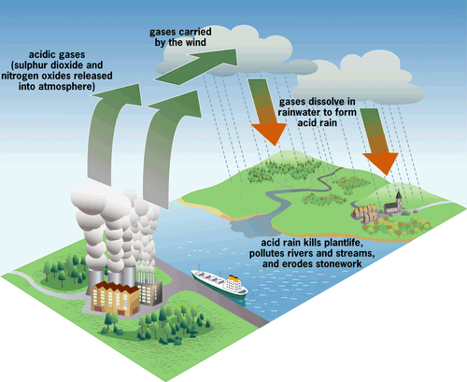

Slide 10
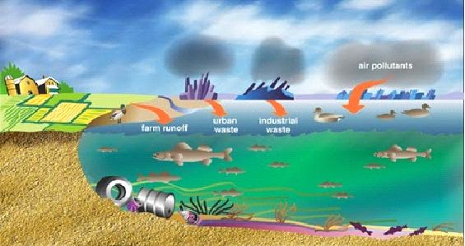
The impact of acid rain
1. Deteriorates building that is made of rock
2. Acidification of soil and lakes
3. Separation of poisonous minerals such as aluminum and mercury from the surrounding ground, increasing the risk of contamination to lakes/water sources
4. Deteriorates trees and forests.

Slide 11
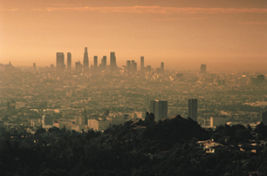
4.
EXPLAIN GROUND LEVEL OZONE;
HOW IT DERIVES FROM NITROGEN
OXIDES AND HYDROCARBONS.

Slide 12
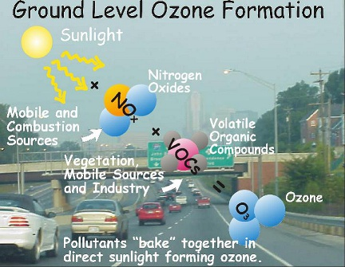

Slide 13
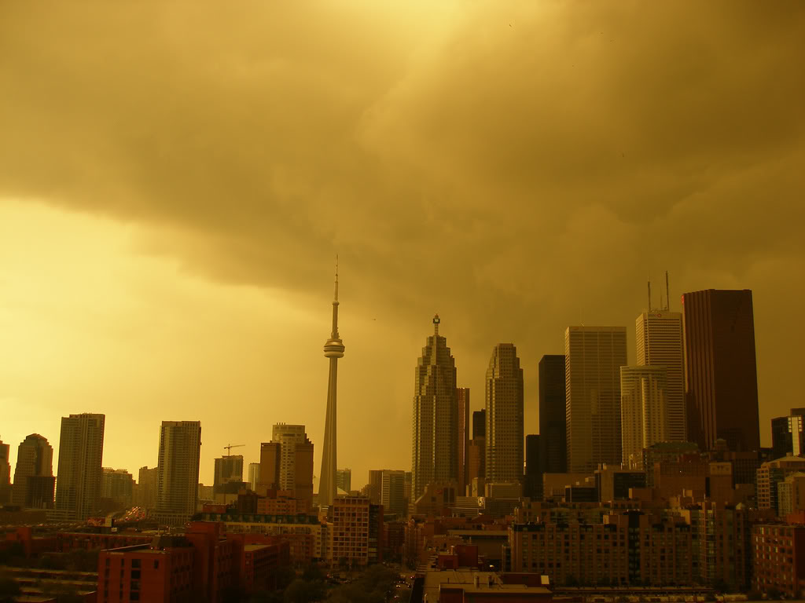
Ground-level ozone and smog
Ozone also occurs in very small amounts at ground level. It is produced at ground level through a reaction between sunlight and volatile organic compounds and nitrogen oxides (NO_{x}), some of which are produced by human activities. Ground-level ozone is a component of urban smog - a serious air quality issue. Smog is most common in the summer months on calm, hot days over urban areas.

Slide 14
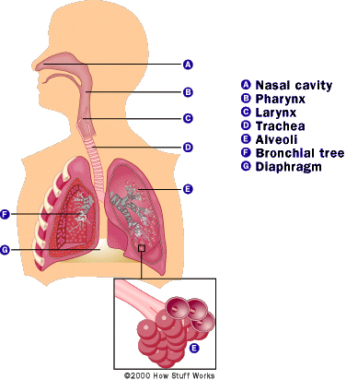

Slide 15
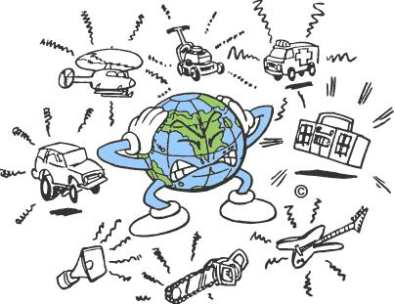
5.
EXPLAIN NOISE POLLUTION AND HOW
IT IS DERIVED FROM TRAFFIC AND
INDUSTRY.

Slide 16
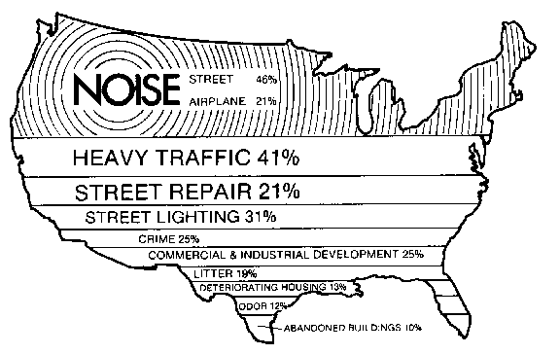

Slide 17
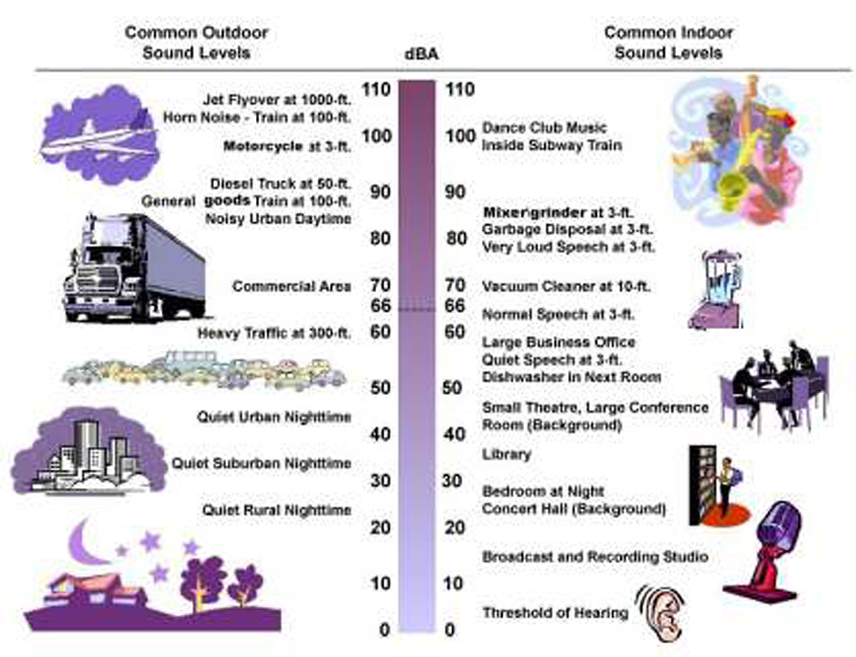

Slide 18
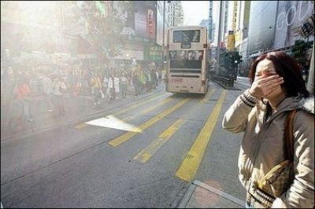
6.
EXPLAIN THE PATTERNS OF URBAN
POLLUTION ACROSS URBAN AREAS
INCLUDING;
POLLUTION PLUMES AND REASONS FOR
DIFFERENT LEVELS OF POLLUTION
WITHIN URBAN AREAS.

Slide 19
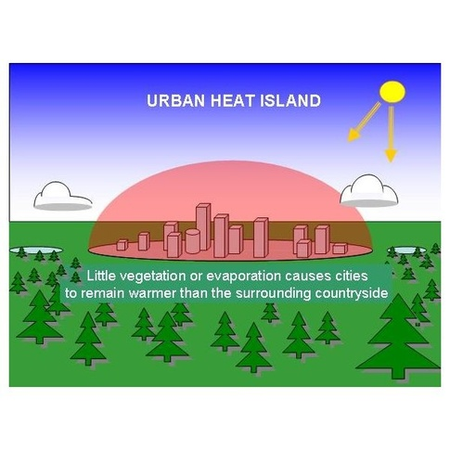

Slide 20
Ambient air is the outdoor air in which humans and other organisms live and breathe.
Its content and quality are directly affected by the day-to-day activities of humans. In turn, ambient air quality has a direct effect on both public health and the welfare of the Earth's ecosystems.
Air normally has no color, odor, or taste. It is a mixture of gases, primarily nitrogen, at about 78%, and oxygen, at about 21%, with the remaining 1% composed of carbon dioxide, methane, hydrogen, argon, and helium.

Slide 21
Human activities, such as manufacturing and the burning of fossil fuels, cause changes in the chemical composition of ambient air through the release of chemical and industrial pollutants into the atmosphere.
a plume is a column of one fluid moving through another.
Several effects control the motion of the fluid,1) including momentum (inertia),
2) diffusion and 3)buoyancy (density differences).

Slide 22
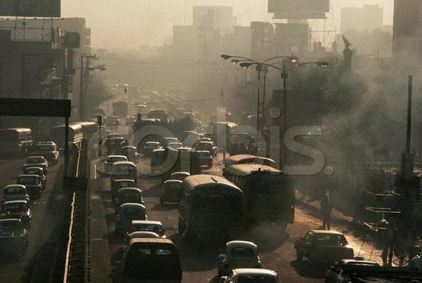
Dense gas plumes — Plumes which are heavier than air because they have a higher density than the surrounding ambient air. A plume may have a higher density than air because it has a higher molecular weight than air (for example, a plume of carbon dioxide). A plume may also have a higher density than air if the plume is at a much lower temperature than the air.

Slide 23
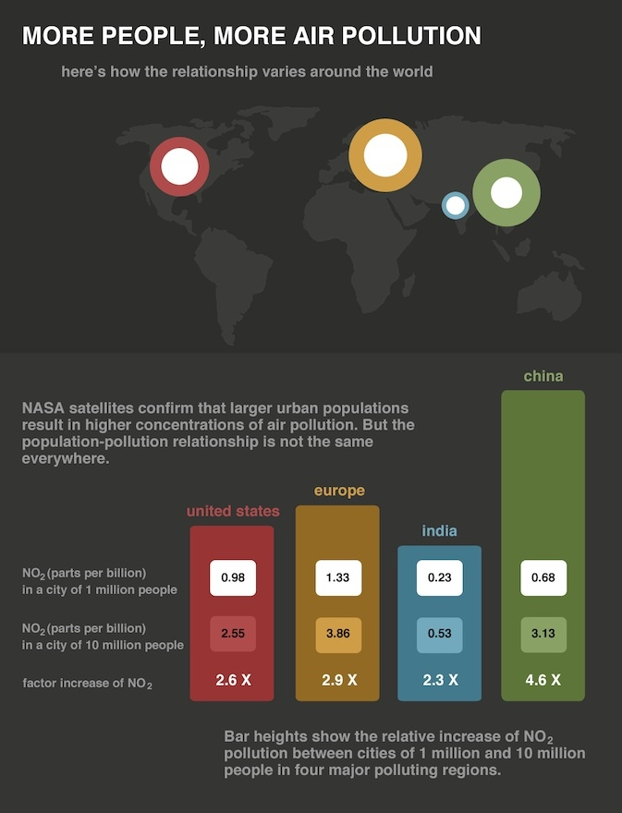

Slide 24
7. With reference to parts of the world with which you are familiar, assess the likely impact of global warming on the natural environment.

Slide 25
Rising sea levels (coastal erosion, coastal flooding, etc.).
Melting ice caps / melting permafrost.
More extreme weather, e.g. drought, rainfall variability, hurricane activity.
Indirect effect on mass movements, soil development, etc.
Credit loss / gain of habitat / migrations / extinctions / breeding behaviour.
Effect on distribution of plant species / staple crops / biomes.

Slide 26
Chapter 13
Atmospheric Science and Air Pollution

Slide 27
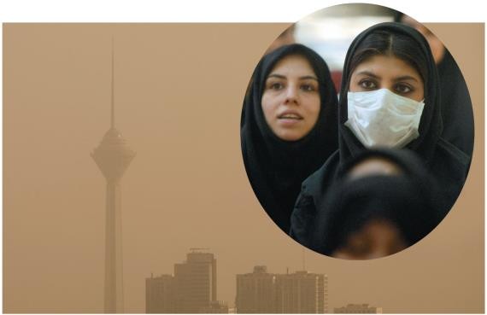
This lecture will help you understand:
Earth’s atmosphere
Weather, climate, and atmospheric conditions
Outdoor pollution and solutions
Stratospheric ozone depletion
Acidic deposition and consequences
Indoor air pollution and solutions

Slide 28
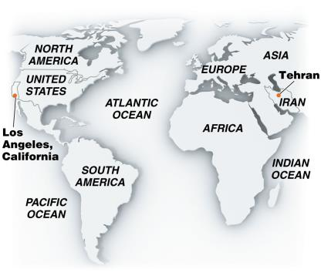
Central Case Study: L.A. and Its Sister City, Tehran, Struggle for a Breath of Clean Air
Vehicles caused smog in Los Angeles from 1970s to 1990s
Policies and technologies improved its air qualities
But its “sister cities” are not as clean
Tehran, Iran, is very polluted
Old cars use cheap gas
Topography, immigration, etc., make things worse
Air pollution kills 3,600/month in Tehran

Slide 29
Outdoor air pollution
Air pollutants: gases and particulate material added to the atmosphere
Can affect climate or harm people or other organisms
Air pollution: the release of pollutants
Outdoor (ambient) air pollution: pollution outside
Has recently decreased due to government policy and improved technologies in developed countries
Developing countries and urban areas still have significant problems
Greenhouse gas emissions may be our worst problem

Slide 30
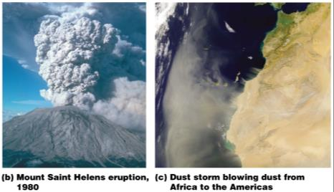
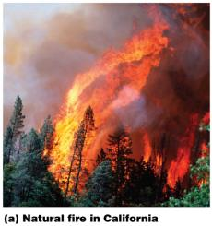
Natural sources can pollute
Fires generate soot and gases
Winds send huge amounts of dust aloft
Even across oceans
Volcanoes release particulate matter, sulfur dioxide
Humans make impacts worse
Farming, grazing cause erosion, desertification
Fire suppression leads to worse fires

Slide 31
We create outdoor air pollution
Humans generate many types of air pollution
Point sources: specific spots where large quantities of pollutants are discharged (power plants)
Non-point sources: more diffuse, consisting of many small, widely spread sources (automobiles)
Primary pollutants: directly harmful or can react to form harmful substances (soot and carbon monoxide)
Secondary pollutants: form when primary pollutants react with constituents of the atmosphere

Slide 32
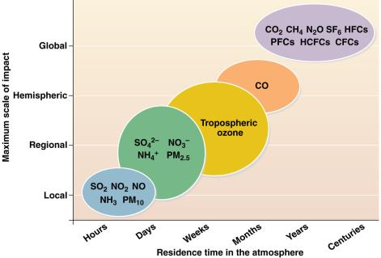
Pollutants exert local and global effects
Residence time: the time a pollutant stays in the atmosphere
Pollutants with brief residence times exert localized impacts over short time periods
Particulate matter, automobile exhaust
Pollutants with long residence times exert regional or global impacts
Greenhouse gases
Ozone destroyers

Slide 33
Legislation addresses pollution
The Clean Air Act (1963, amended in 1970, 1990)
Funds research for pollution control
Sets standards for air quality, limits on emissions
Allows citizens to sue parties violating the standards
Introduced a cap-and-trade program for sulfur dioxide
The EPA sets standards for emissions and pollutants
States monitor air quality
They develop, implement, and enforce regulations
They submit plans to the EPA for approval
The EPA takes over enforcement if plans are inadequate

Slide 34
Criteria pollutants: carbon monoxide
Criteria pollutants: especially great threats to humans
Carbon monoxide, sulfur dioxide, nitrogen dioxide, tropospheric ozone, particulate matter, lead
127 million Americans live in areas that violate standards for at least one criteria pollutant
Carbon monoxide (CO): colorless, odorless gas
Produced primarily by incomplete combustion of fuel
From vehicles and engines, industry, waste combustion, residential wood burning
Prevents blood hemoglobin from binding with oxygen

Slide 35
Criteria pollutants: SO₂ and NO_{x}
Sulfur dioxide (SO₂): colorless gas with a strong odor
Coal emissions from electricity generation, industry
Can form acid deposition
Nitrogen dioxide (NO₂): foul-smelling red-brown gas
Contributes to smog and acid deposition
Nitrogen oxides (NO_{x}): formed when nitrogen and oxygen react at high temperatures in engines
Vehicles, electrical utilities, industrial combustion

Slide 36
Criteria pollutants: tropospheric ozone
Tropospheric ozone (O₃): a colorless gas
A secondary pollutant created from sunlight, heat, nitrogen oxides, volatile carbon-containing chemicals
A major component of smog
Participates in reactions that harm tissues and cause respiratory problems
The pollutant that most frequently exceeds EPA standards

Slide 37
Criteria pollutants: particulate matter and lead
Particulate matter: suspended solid or liquid particles
Damages respiratory tissue when inhaled
Primary pollutants: dust and soot
Secondary pollutants: sulfates and nitrates
From dust and combustion processes
Lead: in gasoline and industrial metal smelting
Bioaccumulates and damages the nervous system
Banned in gasoline in developed, but not in developing, countries

Slide 38
Agencies monitor emissions
State and local agencies monitor and report to the EPA emissions of:
Carbon monoxide, sulfur dioxide, particulate matter, lead, and all nitrogen oxides
Tropospheric ozone, a secondary pollutant, has no emissions to monitor
Agencies monitor volatile organic compounds (VOCs):
Emitted by engines and industrial processes
VOCs can react to produce ozone

Slide 39
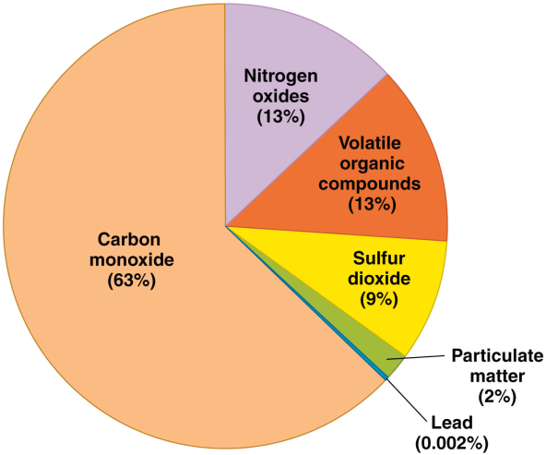
U.S. air pollution
In 2008, the U.S. emitted 123 million tons of the six monitored pollutants

Slide 40
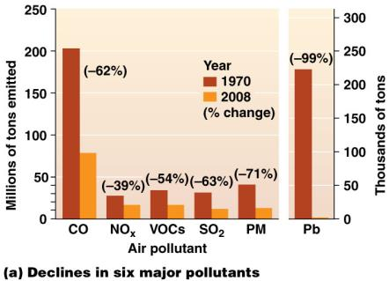
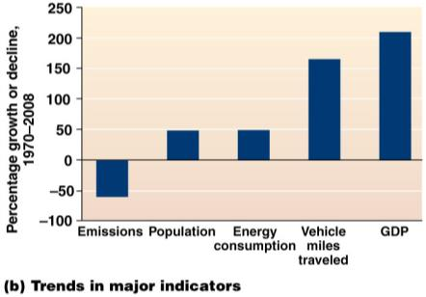
We have reduced U.S. air pollution
Total emissions of the six monitored pollutants have declined 60% since the Clean Air Act of 1970
Despite increased population, energy consumption, miles traveled, and gross domestic product

Slide 41
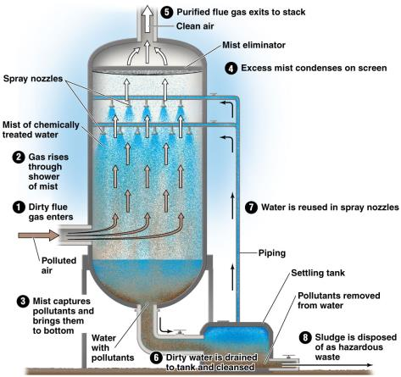
We have reduced emissions
Federal policies and technology
Cleaner-burning engines and catalytic converters
Reduced SO₂ emissions
Permit trading programs and clean coal technologies
Scrubbers: chemically convert or physically remove pollutants before they leave smokestacks
Phaseout of leaded gasoline

Slide 42
We still have more to do…
The reduction in outdoor air pollution since 1970 is one of our greatest accomplishments
Saving the lives of 200,000 Americans since 1970
There is room for improvement:
Concerns over new pollutants and greenhouse gas emissions
U.S. carbon dioxide emissions increased 44% (1970–2008)
The Supreme Court ruled that the EPA could regulate carbon dioxide as a pollutant
There is formidable political opposition to this

Slide 43
Toxic substances pose health risks
Toxic air pollutants: substances that cause …
Cancer, reproductive defects, or neurological, immune system, developmental, or respiratory problems
The EPA regulates 188 toxic air pollutants
Including mercury, VOCs, methylene chloride
Toxic air pollutants cause 36 cancer cases per 1 million people
Clean Air Act regulations helped reduce emissions by more than 35% since 1990

Slide 44
Industrializing nations suffer increasing pollution
Outdoor pollution is getting worse in developing nations
Polluting factories and power plants, increasing numbers of cars
Emphasize economic growth, not pollution control
People burn traditional fuels (wood and charcoal)
China has the world’s worst air pollution
Coal burning, more cars, power plants, factories
Causing over 300,000 premature deaths/year
China is reducing pollution (closing factories, cleaner fuels, raising efficiency standards, cleaner energy, etc.)

Slide 45
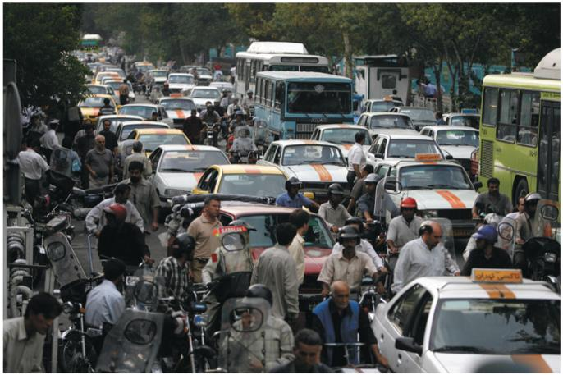
Pollution in developing nations is high
In Tehran, vehicles emit 5,000 tons of pollutants each day!

Slide 46
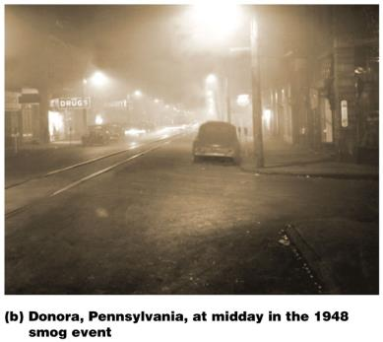
Smog: our most common air quality problem
Smog: an unhealthy mixture of air pollutants over urban areas
Industrial smog: burning coal or oil releases
CO₂, CO, soot, mercury, sulfur
Sulfuric acid is formed
Regulations in developed countries reduced smog
Coal-burning industrializing countries faces health risks
Due to lax pollution control
Smog in Donora, PA, killed 21 people and sickened 6,000

Slide 47
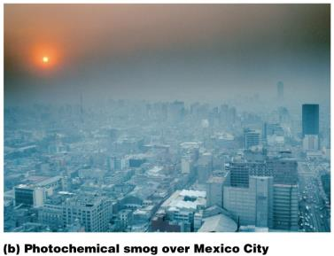
Photochemical (brown air) smog
Sunlight drives a chemical reactions between primary pollutants and atmospheric compounds
Forming ozone, NO₂, and many other compounds
Appears as a brownish haze
Formed in hot, sunny cities surrounded by mountains
Morning traffic releases NO and VOCs
Irritates eyes, noses, and throats
In 1996, photochemical smog killed 300 and sickened 400,000 in 5 days

Slide 48
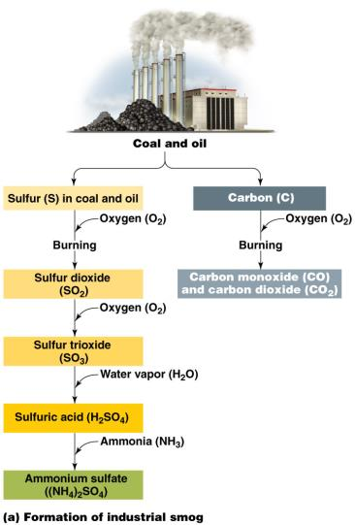
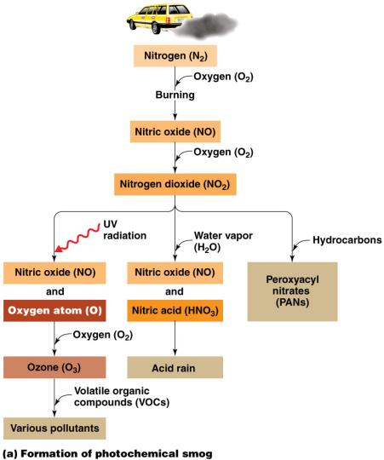
Creation of smog
Industrial smog
Photochemical smog

Slide 49
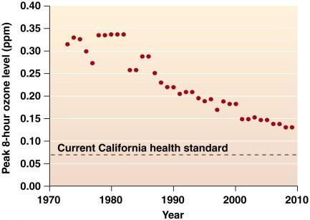
We can reduce smog
Pollution control technology
Vehicle inspection programs
Financial incentives to replace aging vehicles
Restricting driving
Cleaner burning fuels
Cleaner industrial facilities
Close those that can’t improve
Pollution indicator boards
But…increased population and cars can wipe out advances

Slide 50
Synthetic chemicals deplete stratospheric ozone
Ozone in the lower stratosphere absorbs the sun’s ultraviolet (UV) radiation
UV radiation can damage tissues and DNA
Ozone-depleting substances: human-made chemicals that destroy ozone
Halocarbons: human-made compounds made from hydrocarbons with added chlorine, bromine, or fluorine
Chlorofluorocarbons (CFCs): halocarbons used as refrigerants, in fire extinguishers, in aerosol cans, etc.
They stay in the stratosphere for a century

Slide 51
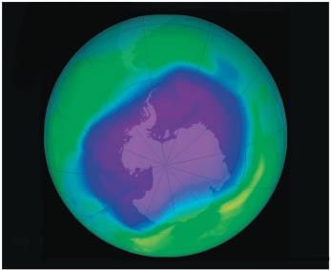
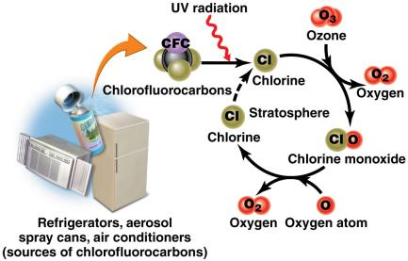
CFCs destroy ozone
Sunlight releases chlorine atoms that split ozone
Ozone hole: decreased ozone levels over Antarctica
One chlorine atom can destroy 100,000 ozone molecules

Slide 52
The Montreal Protocol
Montreal Protocol (1987): 196 nations agreed to cut CFC production in half by 1998
Later agreements deepened cuts, advanced timetables, and addressed other ozone-depleting chemicals
Industry shifted to safer alternative chemicals
We stopped the Antarctic ozone hole from getting worse
Challenges still face us
CFCs will remain in the stratosphere for decades
It can serve as a model for international environmental cooperation

Slide 53
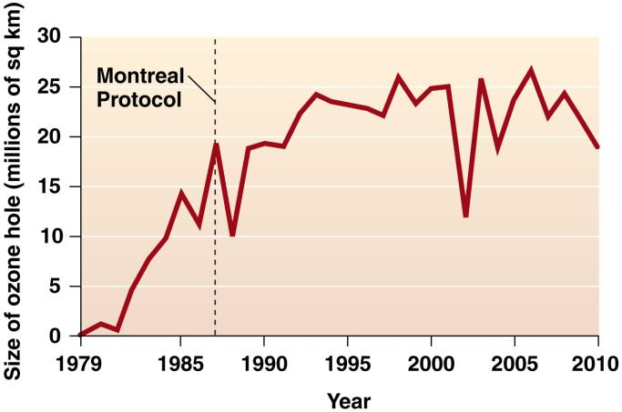
The ozone layer has stopped growing
Phasing out ozone-depleting substances in 1987 worked—the Antarctic ozone hole has stopped growing

Slide 54
Acid deposition
Acid deposition is another transboundary issue
Acid deposition: the deposition of acid, or acid-forming, pollutants from the air onto Earth’s surface
From automobiles, electric utilities, industrial facilities
Acid rain: precipitation containing acid
Rain, snow, sleet, hail
Atmospheric deposition: the wet or dry deposition of pollutants (mercury, nitrates, organochlorines, etc.)

Slide 55
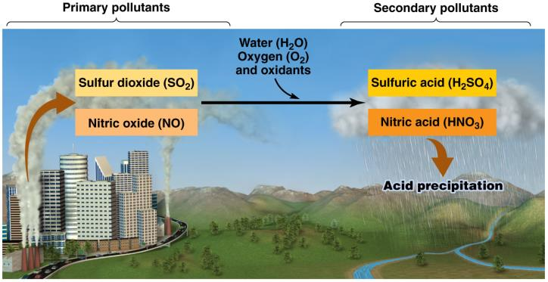
Burning fossil fuels produces acid rain
Burning fossil fuels releases sulfur dioxide and nitrogen oxides
These compounds react with water, oxygen, and oxidants to form sulfuric and nitric acids

Slide 56
Impacts of acid deposition
Nutrients are leached from topsoil
Soil chemistry is changed
Toxic metal ions (aluminum, zinc, etc.) are converted into soluble forms that pollute water
Affects surface water and kills fish
Damages crops
Erodes stone buildings, corrodes cars, erases writing on tombstones

Slide 57
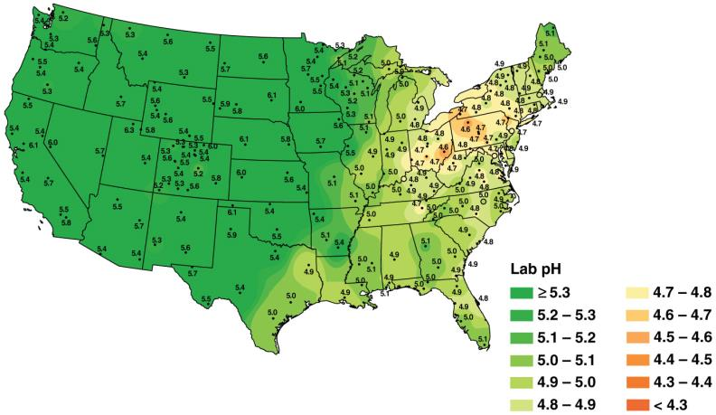
pH values of precipitation in the U.S.
Regions of greatest acidification are downwind of heavily industrialized sources of pollution

Slide 58
We have begun to address acid deposition
The Clear Air Act (1990) established an emissions trading program for sulfur dioxide
Benefits outweighed costs 40:1
New technologies such as scrubbers have helped
Policies and regulations have lowered U.S. emissions of sulfur and nitrogen oxides 43% since 1989
Acid deposition is worsening in the developing world
Coal-burning China emits the most sulfur dioxide and has the world’s worst acid rain problem

Slide 59
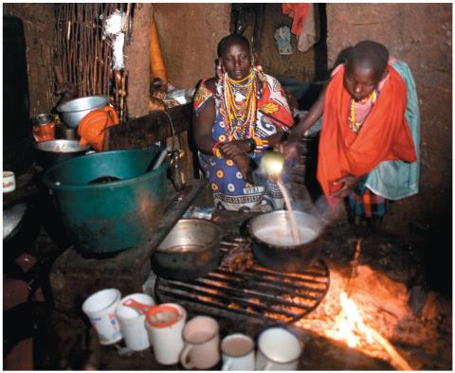
Indoor air pollution in the developing world
Indoor air pollution: in workplaces, schools, and homes
Causes greater health effects than outdoor pollution
The poor in developing nations burn wood, charcoal, dung, and crop wastes
In buildings with little to no ventilation
Killing 1.6 million/year

Slide 60
Indoor air pollution in the developed world
The most dangerous indoor pollutants in developed nations are cigarette smoke and radon
Cigarette smoke causes eye, nose, and throat irritation
Lung cancer kills 160,000/year in the U.S.
Radon: a radioactive gas resulting from natural decay of rock, soil, or water that can seep into buildings
Kills 21,000/year in the U.S.
New homes are being built that are radon resistant

Slide 61
VOCs pollute indoor air
The most diverse group of indoor air pollutants
Released by everything from plastics and oils to perfumes and paints; “new car smell”
Some are released in large amounts when new
Others are released each time they are used
Health implications are unclear because concentrations are low
Formaldehyde leaking from pressed wood and insulation irritates mucous membranes and induces skin allergies

Slide 62
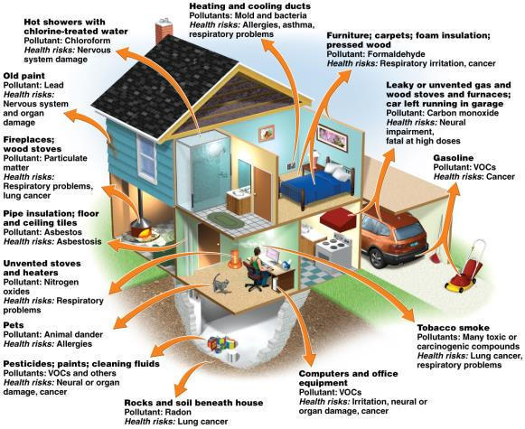
Homes contain many indoor pollutants
Sick building syndrome: a sickness produced by indoor pollution in which the specific cause is not identified

Slide 63
We can reduce indoor air pollution
Keys to alleviating indoor air pollution include:
Using low-toxicity materials, monitoring air quality, keeping rooms clean, provide adequate ventilation
People in developed nations can:
Limit use of plastics and treated wood
Limit exposure to toxic substances (pesticides, etc.)
Test homes and offices for radon and mold
Use CO detectors
Keep rooms and air ducts clean and free

Slide 64
Conclusion
Indoor air pollution is a potentially serious health threat
But we can minimize our risk
Outdoor air pollution has been addressed by:
Government legislation, regulations, and technology
Reduction in outdoor air pollution represents some of the greatest strides in environmental protection
But there is still room for improvement, especially in developing countries

