Slide 1
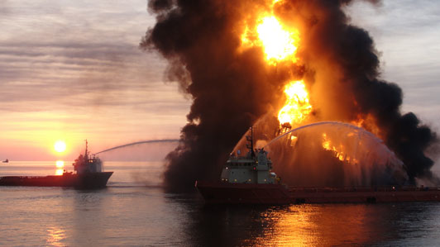
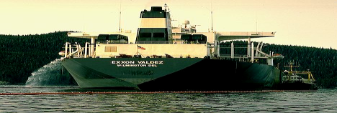
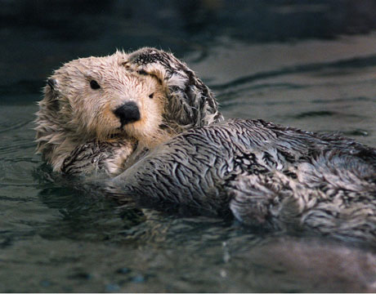
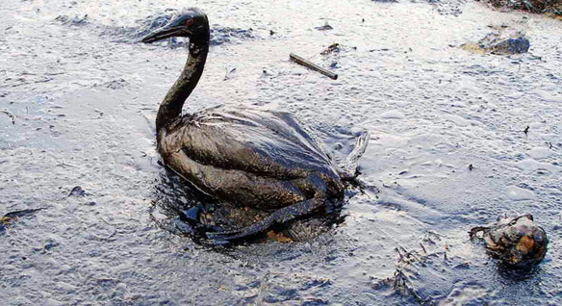
Tanker accidents and blowouts at offshore drilling rigs can be extremely devastating to marine life, especially diving birds.

Slide 2
AICE
QUESTION
# 3

Slide 3
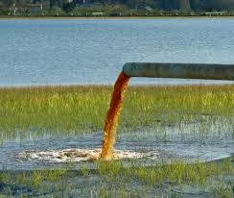
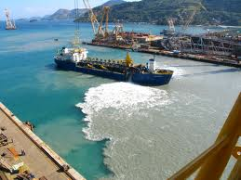
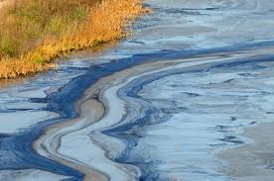
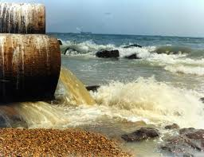
PREVENTING AND REDUCING
SURFACE WATER POLLUTION
The key to reducing nonpoint pollution – most of it from agriculture – is to prevent it from reaching bodies of water.
Farmers can reduce runoff by planting buffers and locating feedlots away from steeply sloped
land, flood zones, and surface water.

Slide 4
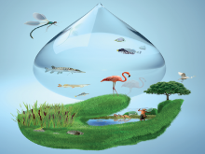
Most developed countries use laws to set water pollution standards, but such laws rarely exist in developing countries.
The U.S. Clean Water Act sets standards fro allowed levels of key water pollutants and
requires polluters to get permits.

Slide 5
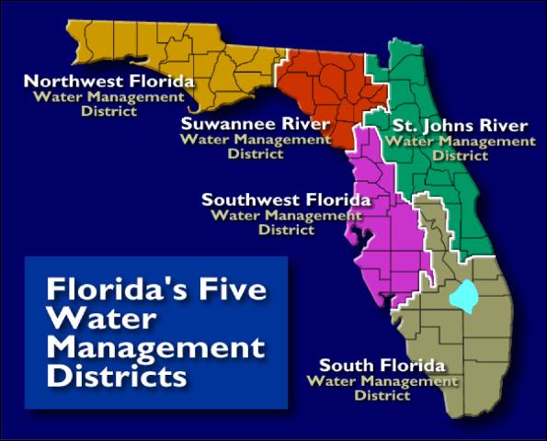

Slide 6
a biological process in which aerobic bacteria remove as much as 90% of dissolved and biodegradable, oxygen demanding organic wastes.
a physical process that uses screens and a grit tank to remove large floating objects and allows settling.

Slide 7
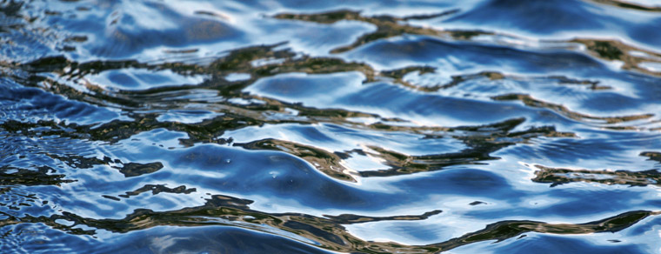
Advanced or tertiary sewage treatment: Uses series of chemical and physical processes to remove specific pollutants left (especially nitrates and phosphates).
Water is chlorinated to remove coloration and to kill disease-carrying bacteria and some viruses (disinfect).

Slide 8
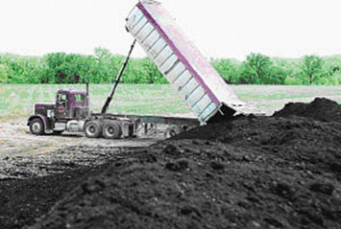
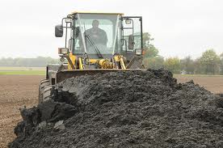
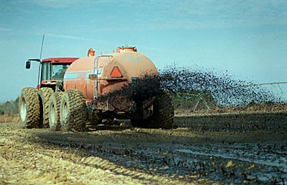
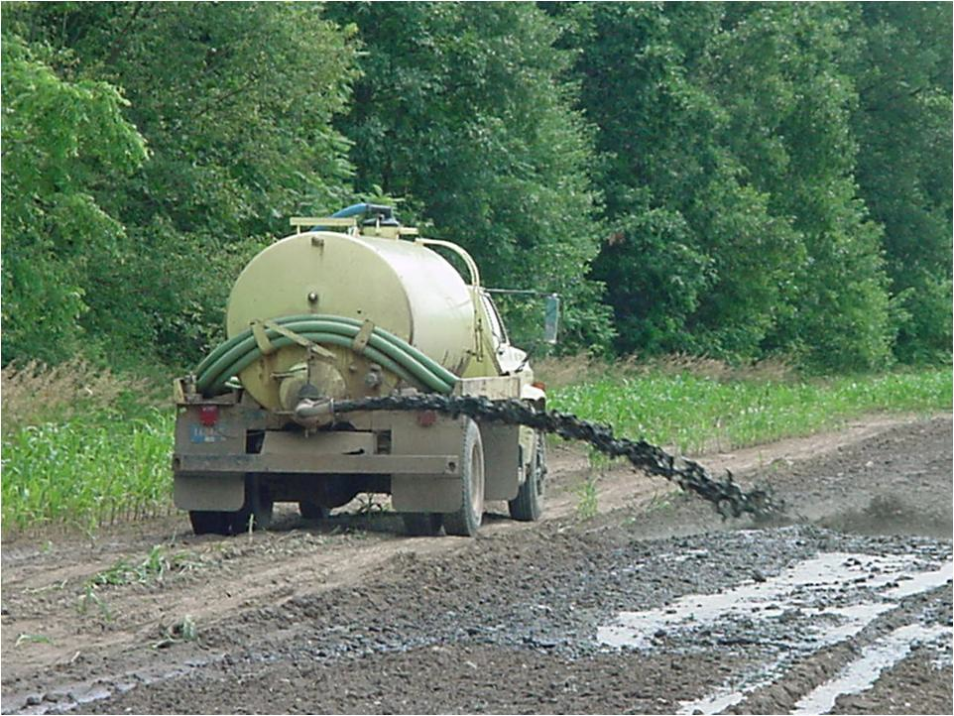
Sewage sludge can be used as a soil conditioner but this can cause health problems if it contains infectious bacteria and toxic chemicals.
Preventing toxic chemicals from reaching
sewage treatment plants would eliminate such chemicals from the sludge and water discharged from such plants.

Slide 9
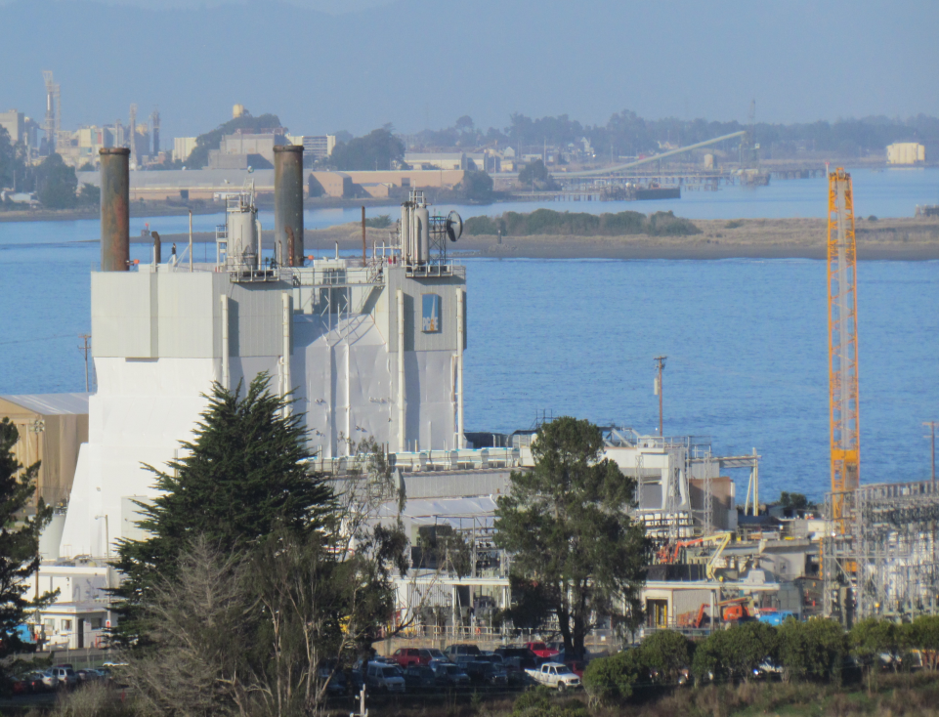
Natural and artificial wetlands and other ecological systems can be used to treat sewage.
California created a 65 hectare wetland near Humboldt Bay that acts as a natural wastewater
treatment plant for the town of 16,000 people.
• The project cost less than half of the estimated price of a conventional treatment plant.

Slide 10
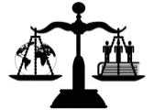
Water pollution laws have significantly improved water quality in many U.S. streams and lakes but there is a long way to go.
Some want to strengthen the U.S. Clean Water Act (CWA) to prevent rather than
focusing on end-of-the-pipe removal.
Many farmers and developers see the CWA as limiting their rights as property owners to fill in wetlands.

Slide 12
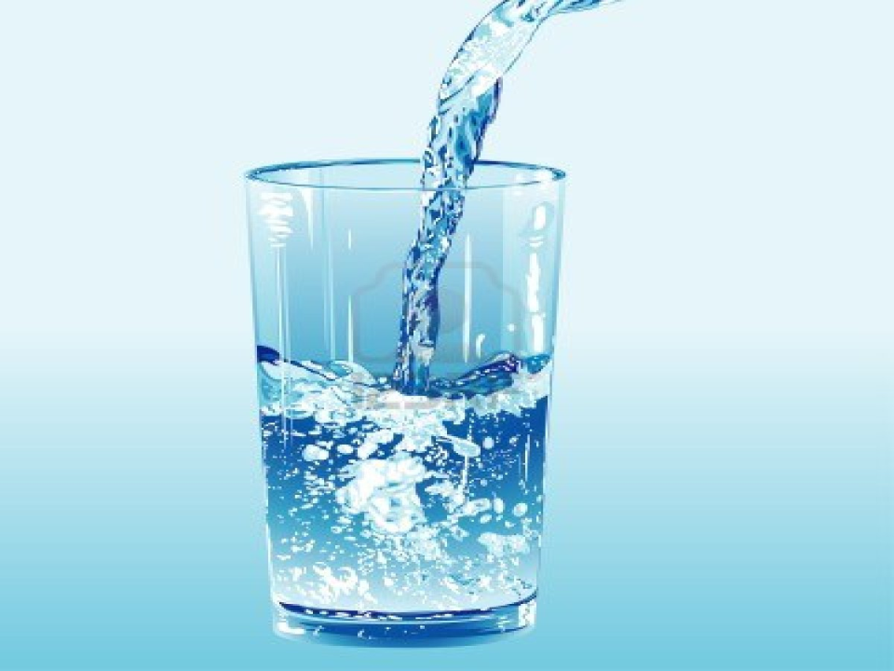
While most developed countries have drinking water quality standards and laws, most developing countries do not.
The U.S Safe Drinking Water Act requires the EPA to establish national drinking water standards (maximum contaminant levels) for any pollutant that may have adverse effects on human health.

Slide 13

The U.N. estimates that 5.6 million Americans drink water that does not meet EPA standards.
1 in 5 Americans drinks water from a treatment plant that violated one or more safety standard.
industry pressures to weaken the Safe Drinking Act:
Eliminate national tests and public notification of violations.
Allow rights to pollute if provider cannot afford to comply.

Slide 14
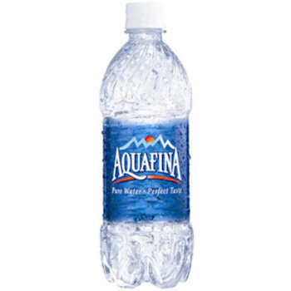
Some bottled water is not as pure
as tap water and costs much more.
1.4 million metric tons of plastic
bottles are thrown away.
Fossil fuels are used to make plastic bottles.
• The oil used to produce plastic bottles in the U.S. each
year would fuel 100,000 cars.

Slide 15
A
I
C
E
Q
U
E
S
T
I
O
N
# 4

Slide 16
A
I
C
E
Q
U
E
S
T
I
O
N
#
5

