Slide 1
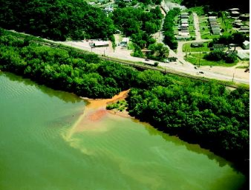
Most developed countries have sharply reduced point-source pollution but toxic chemicals and pollution from nonpoint sources are still a problem.
Stream pollution from discharges of untreated sewage and industrial wastes is a major problem in developing countries.

Slide 3
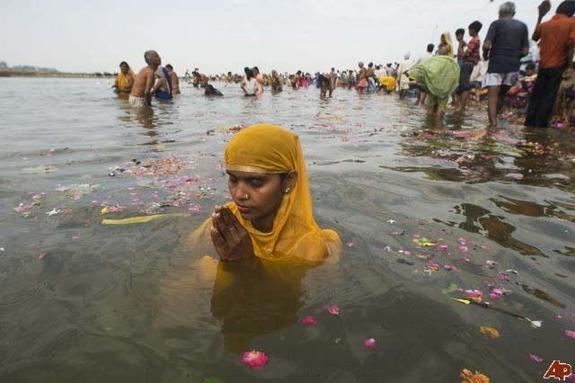
Case Study: India’s Ganges River:
Religion, Poverty, and Health
Religious beliefs, cultural traditions, poverty, and a large population interact to cause severe pollution of the Ganges River in India.
Very little of the sewage is treated.
Hindu believe in cremating the dead to free the
soul and throwing the ashes in the holy Ganges.
• Some are too poor to afford the wood to fully cremate.
• Decomposing bodies promote disease and depletes DO.

Slide 5
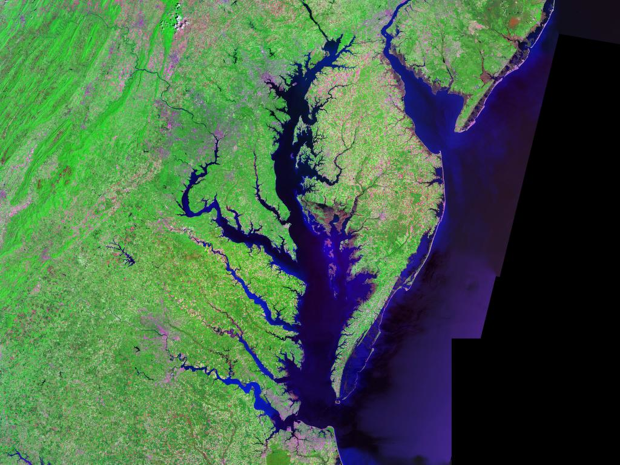
The Chesapeake Bay – An Estuary in Trouble
Pollutants from six states contaminate the shallow estuary, but cooperative efforts
have reduced some of the pollution inputs.

Slide 6
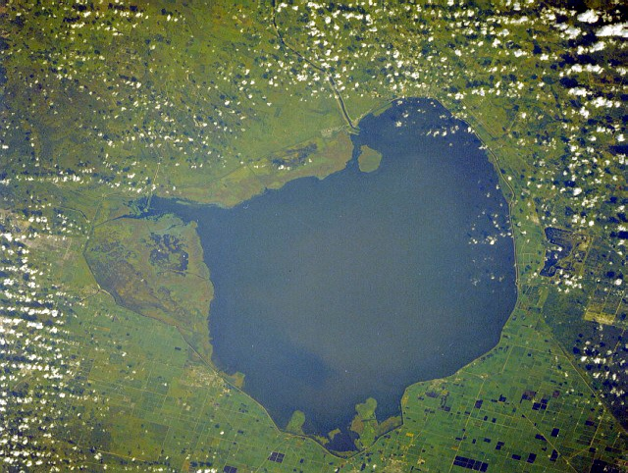
POLLUTION OF FRESHWATER LAKES
Dilution of pollutants in lakes is less effective than in most streams because most lake water is not mixed well and has little flow.
1. Lakes and reservoirs are often stratified
and undergo little mixing.
2. Low flow makes them susceptible to runoff.
3. Various human activities can overload lakes with plant nutrients, which decrease DO and kill some aquatic species.

Slide 7
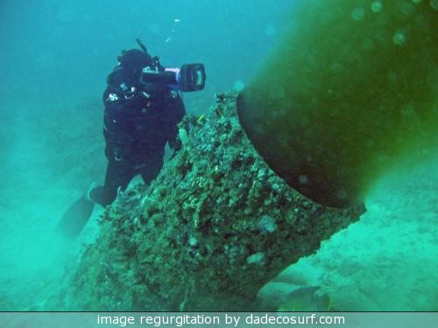
OCEAN POLLUTION
Oceans, if they are not overloaded, can disperse and break down large quantities of degradable pollutants. (MICROBES)
Pollution of coastal waters near heavily populated areas is a serious problem.
About 40% of the world’s population lives
near on or near the coast.
The EPA has classified 4 of 5 estuaries as threatened
or impaired.

Slide 8
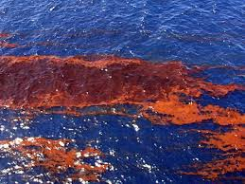
OCEAN OIL POLLUTION
Most ocean oil pollution comes
from human activities on land.
Studies have shown it takes about 3 years for many forms of marine life to recover from large amounts of crude oil (oil directly from ground).
Recovery from exposure to refined oil (fuel oil,
gasoline, etc...) can take 10-20 years for marine life to recover.

Slide 9
AICE QUESTION # 2
KNOW THE AFFECTS
OF MARINE POLLUTION

