Slide 1
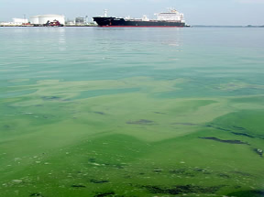
OBJECTIVE 4 HYDROSPHERE
ESSENTIAL QUESTIONS
HOW DOES HUMAN ACTIVITY LEAD TO THE
POLLUTION OF WATER STORES?
HOW CAN THIS FORM OF POLLUTION
BE MANAGED?

Slide 4
^{POLLUTION OF GROUNDWATER}

Slide 5
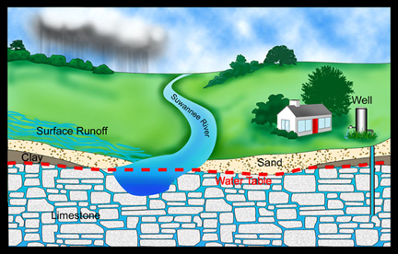
Groundwater can become contaminated with a variety of chemicals because it cannot effectively cleanse itself and dilute and disperse pollutants.
The drinking water for about half of the U.S. population and 95% of those in rural areas
comes from groundwater.

Slide 6

It can take hundreds to thousand of years for contaminated groundwater to cleanse itself of degradable wastes.
Nondegradable wastes (toxic lead, arsenic, flouride) are there permanently.
Slowly degradable wastes (such as DDT) are
there for decades.

Slide 7
Leaks from a number of sources have contaminated groundwater in parts of the world.
According the the EPA, one or more organic chemicals contaminate about 45% of municipal groundwater supplies.
By 2009, the EPA had completed the cleanup of 297,000 of 436,000 underground tanks leaking gasoline, diesel fuel, home heating oil, or toxic solvents.

Slide 8
AICE
QUESTION
# 1

Slide 9
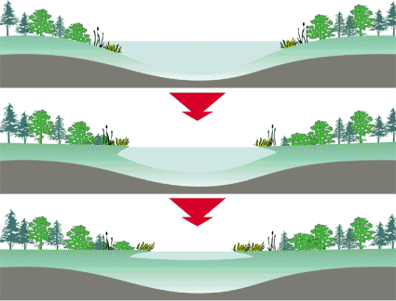
Eutrophication
Eutrophication: the natural nutrient enrichment of a shallow lake, estuary or slow moving stream, mostly from runoff of plant nutrients from the surrounding land.
Cultural eutrophication: human activities accelerate the input of plant nutrients (mostly nitrate- and phosphate-containing effluents) to a lake.
85% of large lakes near major population centers in the U.S. have some degree of cultural eutrophication.

Slide 10
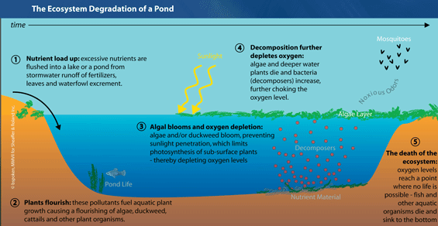

Slide 11
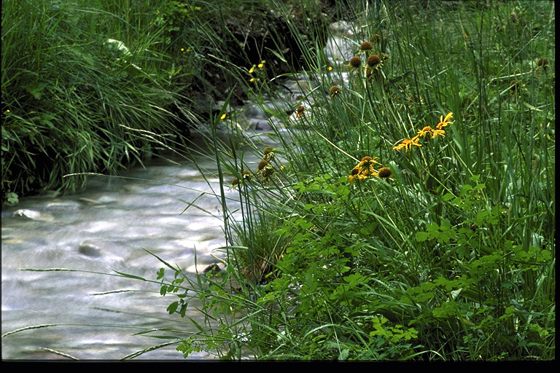
POLLUTION OF FRESHWATER STREAMS
Flowing streams can recover from a moderate level of degradable water pollutants if they are not overloaded and their flows are not reduced.
In a flowing stream, the breakdown of degradable wastes by bacteria depletes DO and creates and oxygen sag curve.
• This reduces or eliminates populations of organisms with high oxygen requirements.

Slide 12
Most developed countries have sharply reduced point-source pollution but toxic chemicals and pollution from nonpoint sources are still a problem.

