Slide 1
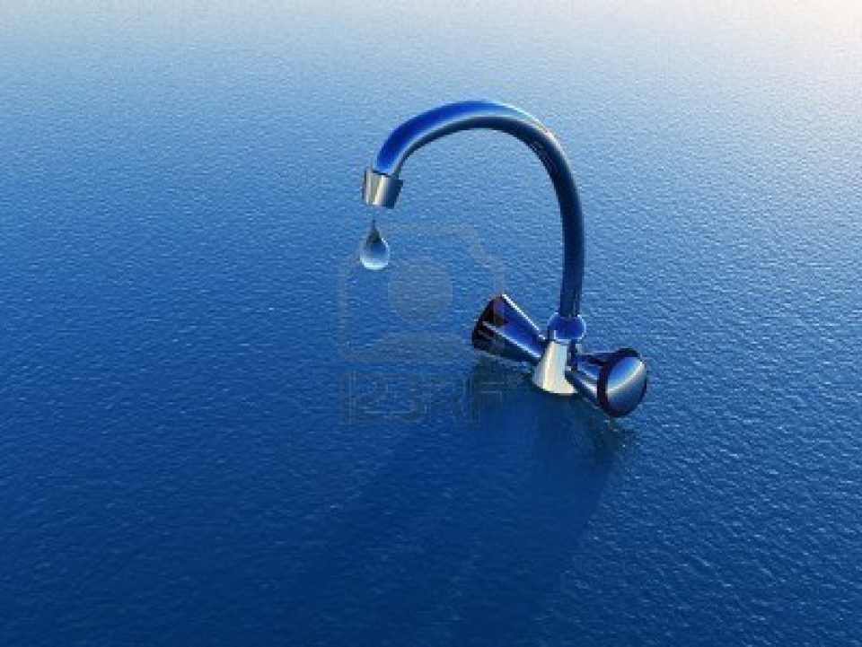
We waste about two-thirds of the water we use, but we could cut this waste to 15%.
65-70% of the water people use throughout the world is lost through evaporation, leaks, and other losses.
Water is underpriced through government subsidies.
The lack of government subsidies for improving the efficiency of water use contributes to water waste.

Slide 2
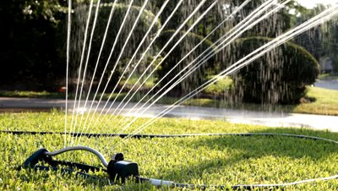
How Would You Vote?
Should water prices be raised sharply to help reduce water waste?
No. Poor people, farmers, ranchers, and small businesses would suffer from price increases.
Yes. People would be more likely to conserve water if it is more expensive.

Slide 3
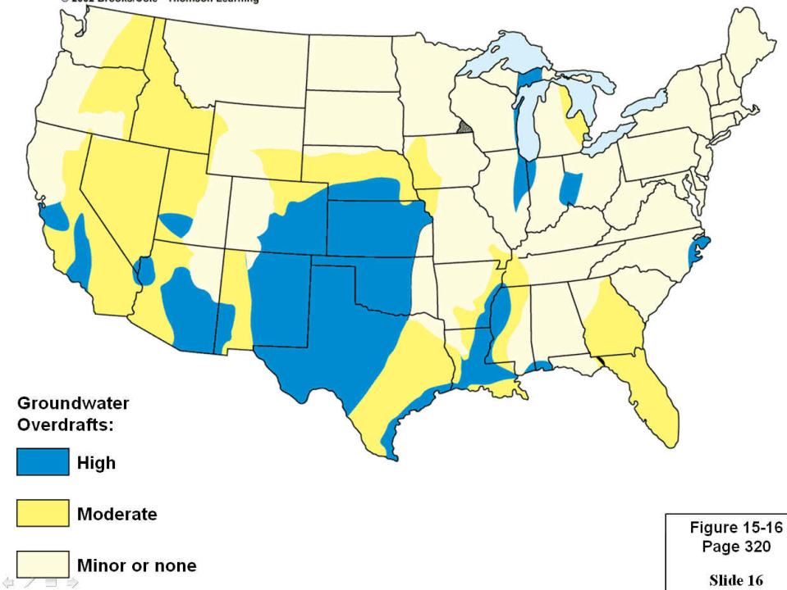
WITHDRAWING GROUNDWATER TO INCREASE SUPPLIES
Most aquifers are renewable resources unless water is removed faster than it is replenished or if they are contaminated.
Groundwater depletion is a growing problem mostly
from irrigation.

Slide 4
AICE
QUESTION

Slide 5
Groundwater overpumping can cause land to sink, and contaminate freshwater aquifers
near coastal areas with saltwater.

Slide 6
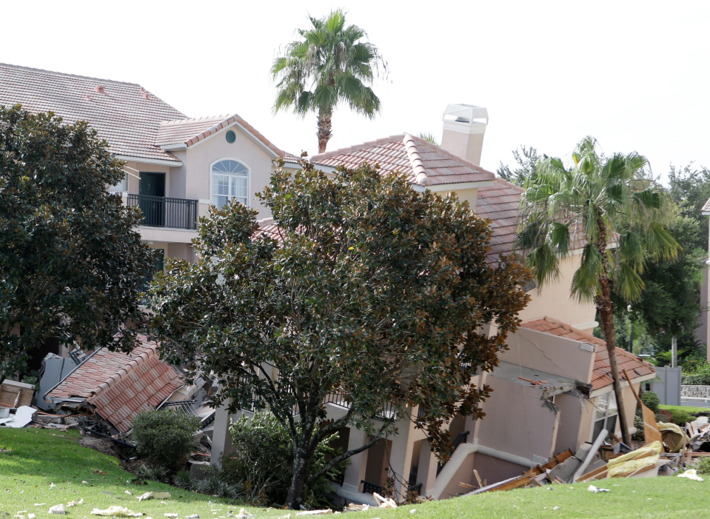
Sinkholes form when the roof of an underground cavern collapses after being drained of
groundwater.

Slide 7
AICE
QUESTION

