Slide 1
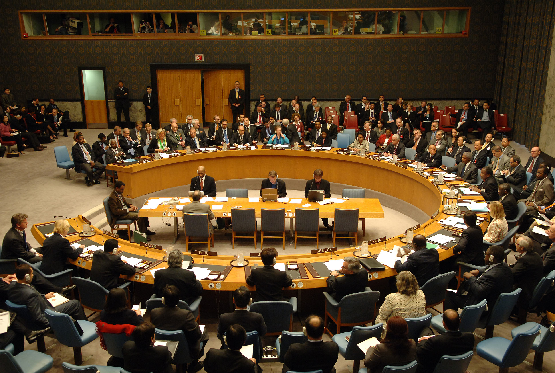
ESSENTIAL QUESTION
TO WHAT EXTENT HAVE MEETINGS BETWEEN
NATIONS AND PRESSURE GROUPS BEEN IMPORTANT
IN HIGHLIGHTING ENVIRONMENTAL AWARENESS
AND MANAGING THE BIOSPHERE?

Slide 2
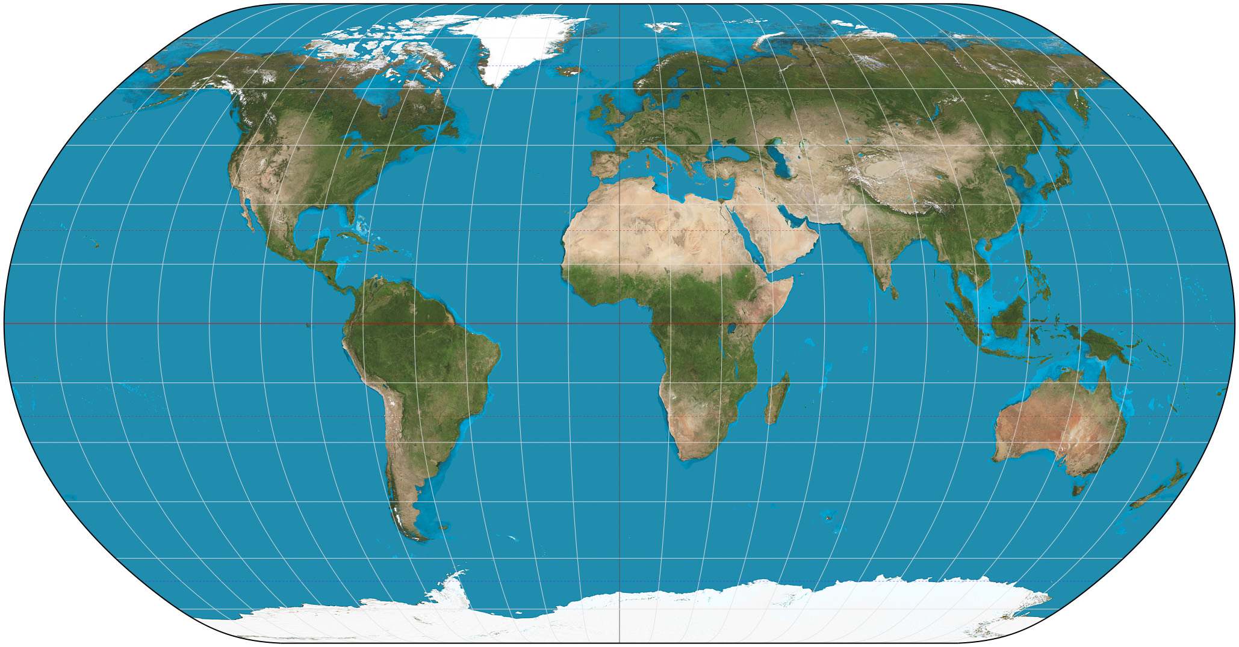
INTERNATIONAL PROTOCOLS
MONTREAL
Montreal Protocol on Substances that Deplete the Ozone Layer
Signed 16 September 1987
Location Montreal
Effective 1 January 1989 if 11 states have ratified by then.
Condition ratification by 20 states
Signatories 46
Ratifiers 197 (all United Nations members, as well as Niue, the Cook Islands, the Holy See and the European Union)
Depositary Secretary-General of the United Nations
Languages Arabic, Chinese, English, French, Russian and Spanish.

Slide 3
INTERNATIONAL PROTOCOLS
RIO DE JANEIRO
United Nations Framework Convention on Climate Change
UNFCCC logo
Signed 9 May 1992
Location New York City, US
Effective 21 March 1994
Condition ratification by 50 states
Signatories 165
Ratifiers 196 (all United Nations member states, as well as Niue, Cook Islands and the European Union)[1]
Depositary Secretary-General of the United Nations
Languages Arabic, Chinese, English, French, Russian and Spanish

Slide 4
INTERNATIONAL PROTOCOLS
KYOTO
Kyoto Protocol
Signed 11 December 1997
Location Kyoto
Effective 16 February 2005
Condition Ratification by 55 States to the Convention, incorporating States included in Annex I which accounted in total for at least 55 per cent of the total carbon dioxide emissions for 1990 of the Parties included in Annex I
Signatories 83
Parties 192
Depositary Secretary-General of the United States
Languages Arabic, Chinese, English, French, Russian and Spanish

Slide 5
INTERNATIONAL PROTOCOLS
BALI
Bali Declaration on Transitioning to Low Global Warming Potential Alternatives to Ozone Depleting Substances
We, the Parties to the Vienna Convention on the Protection of the Ozone Layer and its Montreal Protocol on Substances that Deplete the Ozone Layer, having met in Bali, Indonesia from 21 to 25 November 2011,
Cognizant that certain ozone depleting substances have high global warming potential and that the mitigation of ozone depleting substances could contribute to the reduction of greenhouse gas emissions.

