Slide 1
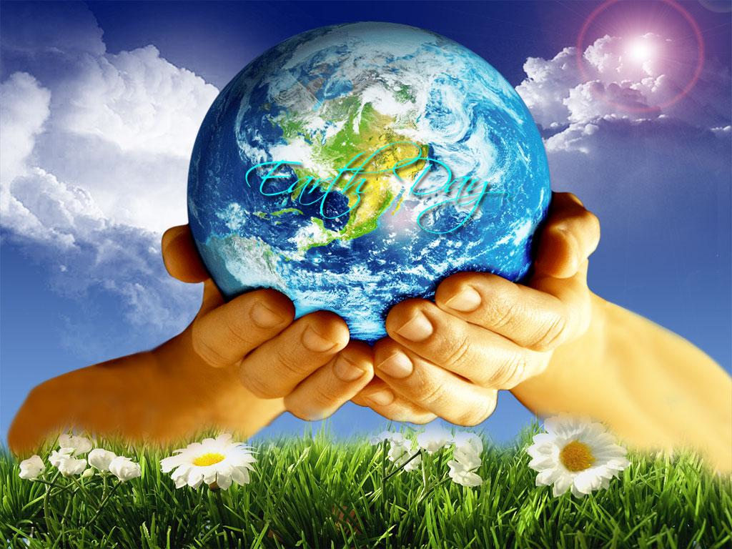
OBJECTIVE 3
ESSENTIAL QUESTION
WHAT METHODS HAVE BEEN USED TO
PRESERVE, CONSERVE AND RESTORE
ECOSYSTEMS?

Slide 2
a scenic or historically important area of countryside protected by the federal government for the enjoyment of the general public or the preservation of wildlife.

Slide 3
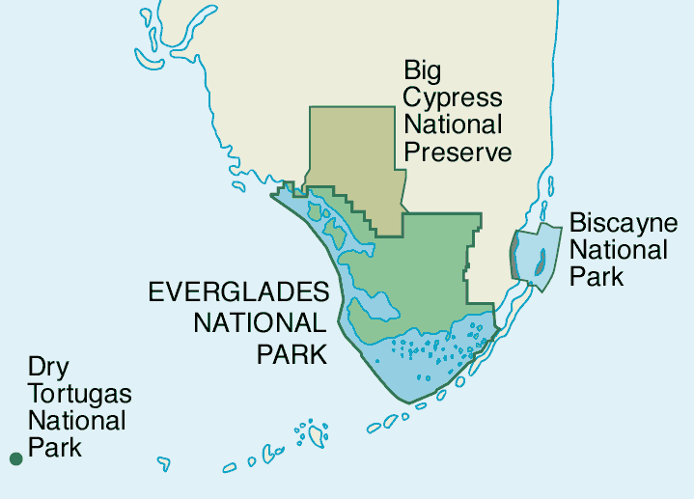

Slide 4
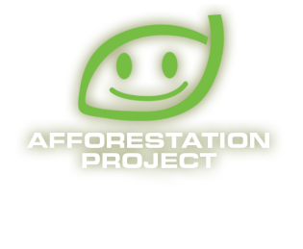
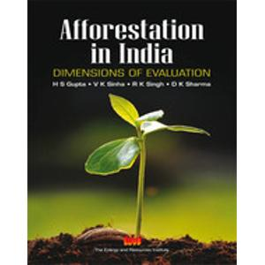
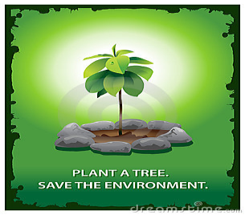
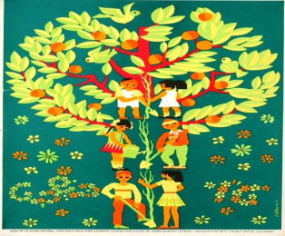
BIOZONE TEXT
PAGE 216
1-2
Afforestation is the establishment of a forest or stand of trees in an area where there was no forest.

Slide 5
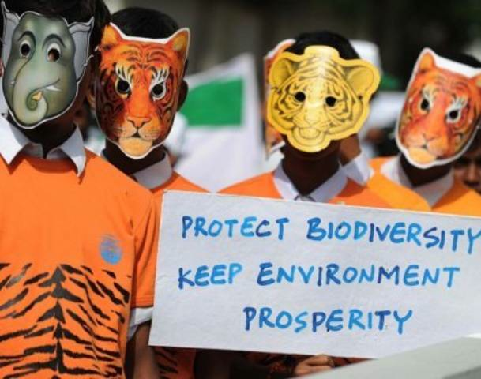
the variety of life in the world or in a particular habitat or ecosystem.

Slide 6
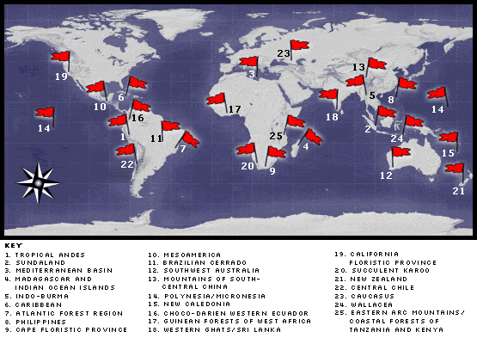

Slide 7
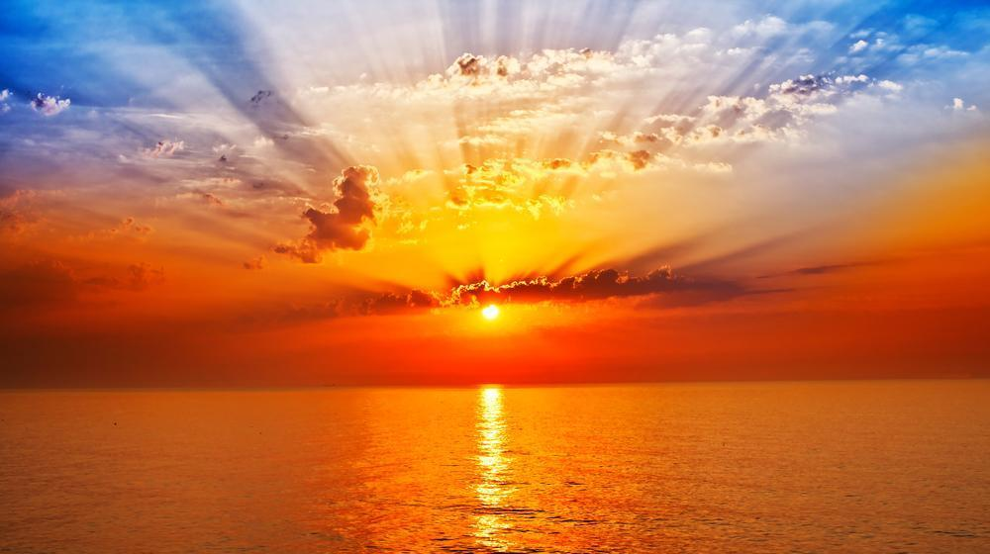
CONSERVE, PRESERVE AND RESTORE
METHODS
NATIONAL PARKS, AFFORESTATION
AND MAINATAINING BIOLOGICLAL DIVERSITY
THE PROCESSES
POLLUTION CONTROL CHANGINGAGRICULTURAL SYSTEMS
ECOTOURISM FOREST CONSERVATION
WILDLIFE MANAGEMENT ECOLOGICAL ISLANDS

Slide 8
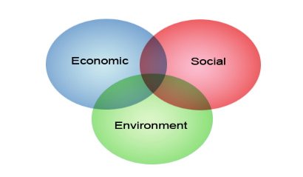
In ecology, sustainability is how biological systems endure and remain diverse and productive.

