Slide 1
ATMOSPHERE
OBJECTIVE 1
1.What are the structural components of the
atmosphere?
2.Why is it important to understand the
Structural components characteristics

Slide 2
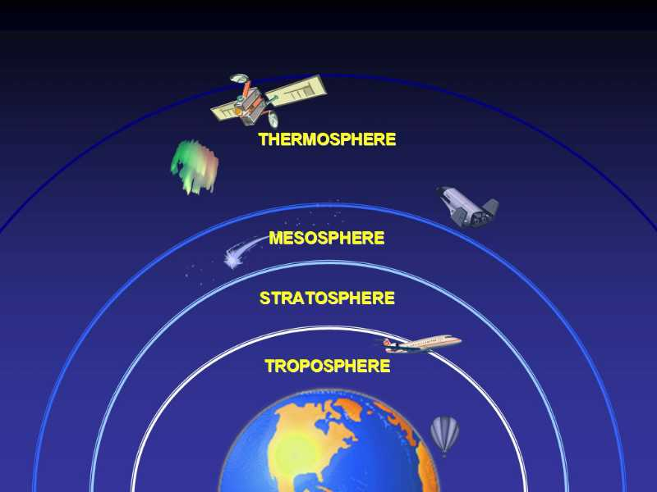
Jump from Space

Slide 3
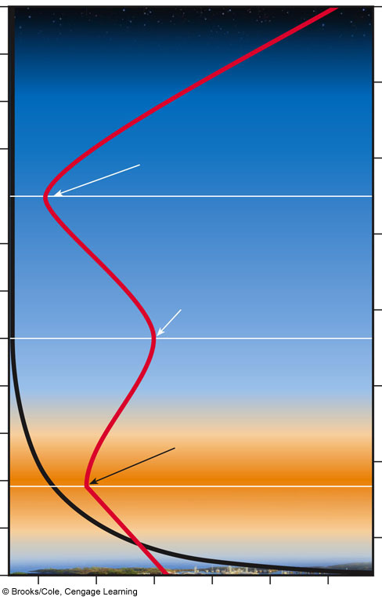
Atmospheric pressure (millibars)
0
200
400
600
800
1,000
120
75
110
Temperature
65
Thermosphere
100
90
Mesopause
55
80
Mesosphere
45
70
Altitude (kilometers)
Altitude (miles)
60
Stratopause
35
50
Stratosphere
40
25
30
Tropopause
15
20
Ozone layer
10
Pressure
Troposphere
5
(Sea level)
0
Pressure =
1,000 millibars at ground level
–80
–40
0
40
80
120
Temperature (˚C)
Notes:
Figure 18.3
Natural capital: The earth’s atmosphere is a dynamic system that includes four layers. The average temperature of the atmosphere varies with altitude (red line). Most UV radiation from the sun is absorbed by ozone (O₃), found primarily in the stratosphere in the ozone layer 17–26 kilometers (10–16 miles) above sea level. Question: Why do you think the temperature falls and rises twice, going from lower to higher altitudes?

Slide 4
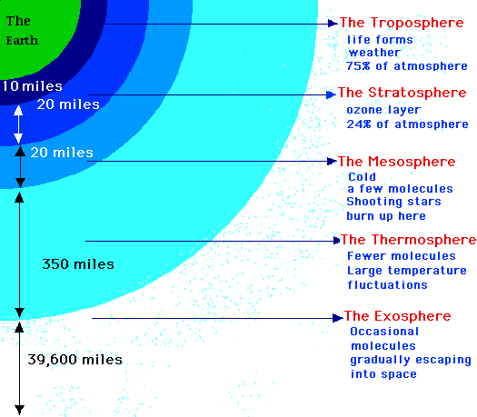

Slide 5
Troposphere
The troposphere begins at the surface and extends to between 9 km (30,000 ft) at the poles and 17 km (56,000 ft) at the equator, with some variation due to weather.
The troposphere is mostly heated by transfer of energy from the surface, so on average the lowest part of the troposphere is warmest and temperature decreases with altitude.
This promotes vertical mixing (hence the origin of its name in the Greek word tropos, meaning "turn").
The troposphere contains roughly 80% of the mass of the atmosphere and nearly all the weather associated cloud genus types.
The tropopause is the boundary between the troposphere and stratosphere.

Slide 6
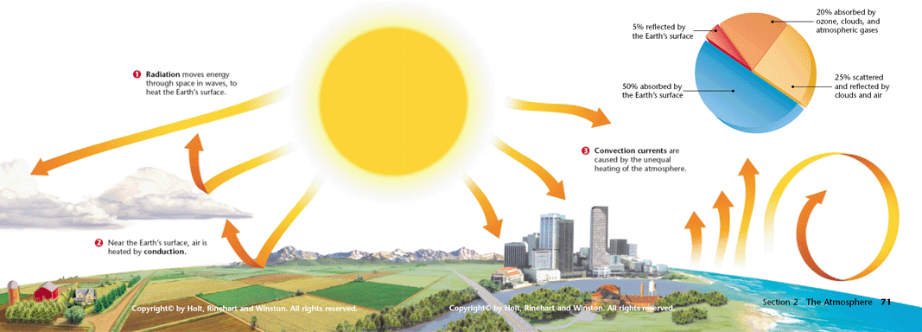
Heat Transfer at the Surface

Slide 7
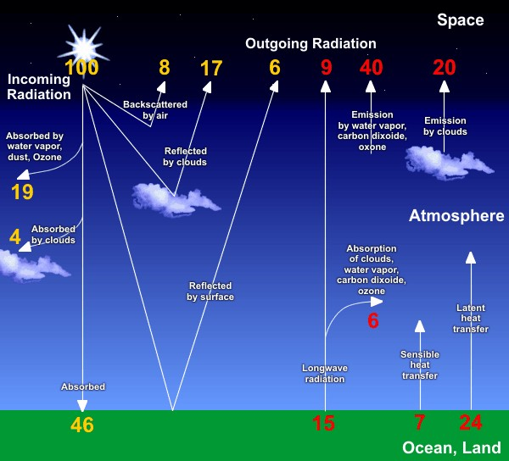

Slide 8
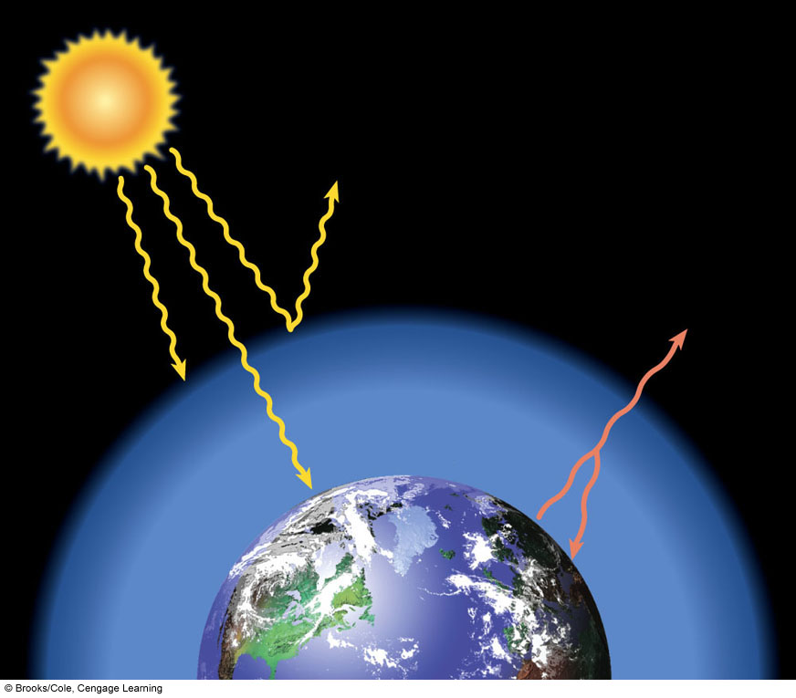
Click here
Solar
radiation
Reflected by
atmosphere
Radiated by
atmosphere
as heat
UV radiation
Most
absorbed
by ozone
Lower Stratosphere
(ozone layer)
Visible
light
Troposphere
Heat radiated
by the earth
Heat
Absorbed
by the earth
Greenhouse
effect
Fig. 3-8, p. 56

Slide 9
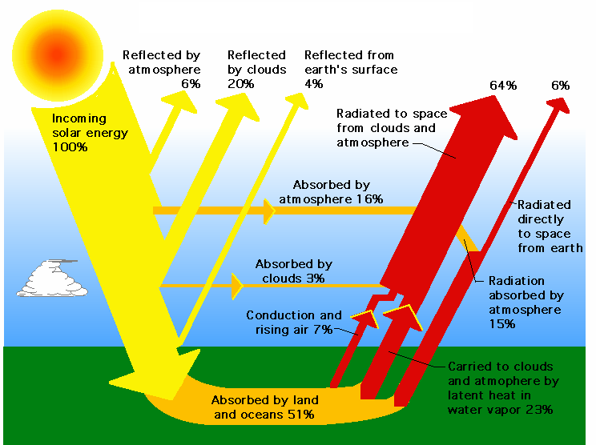

Slide 10
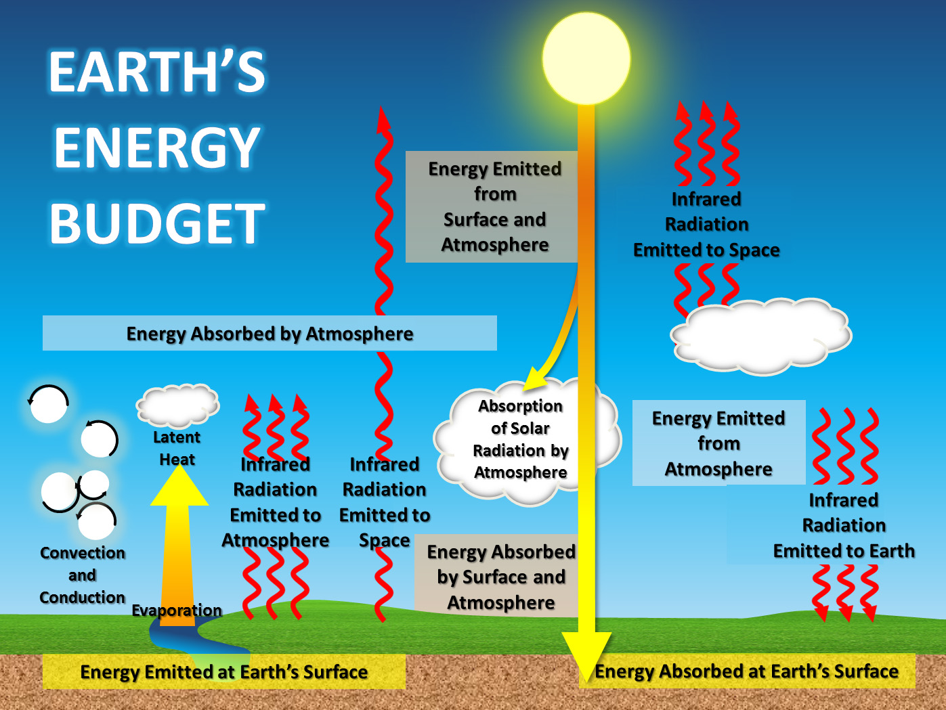

Slide 11
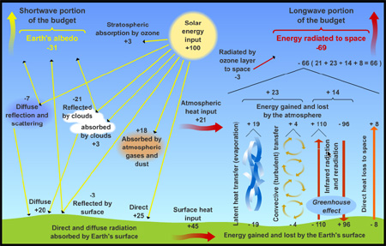

Slide 13
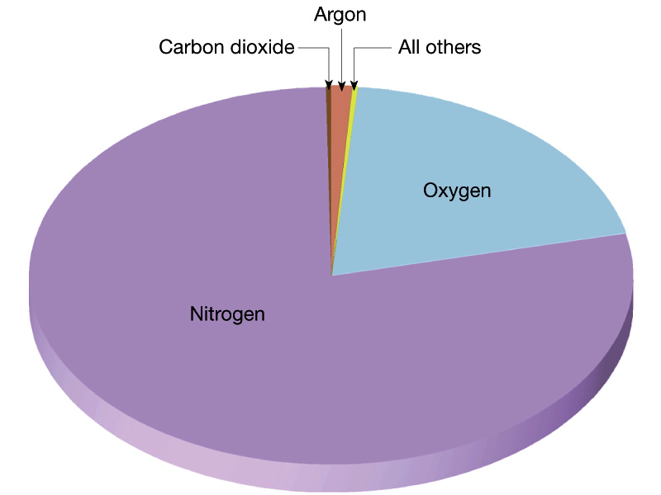

Slide 14
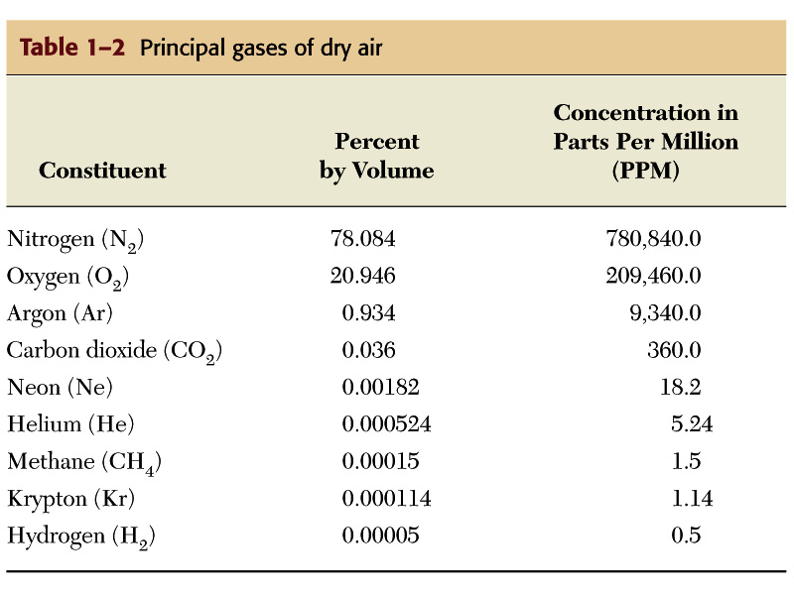

Slide 15
Stratosphere
1) The stratosphere extends from the tropopause at about 12 km (7.5 mi; 39,000 ft) to about 51 km (32 mi; 170,000 ft).
2) Temperature increases with height due to increased absorption of ultraviolet radiation by the ozone layer, which restricts turbulence and mixing.
3) While the temperature may be −60 °C (−76 °F; 210 K) at the tropopause, the top of the stratosphere is much warmer, and may be near freezing.
4) Polar stratospheric or nacreous clouds are occasionally seen in this layer of the atmosphere.
5) The stratopause, which is the boundary between the stratosphere and mesosphere, typically is at 50 to 55 km (31 to 34 mi; 160,000 to 180,000 ft). The pressure here is 1/1000 sea level.

Slide 16
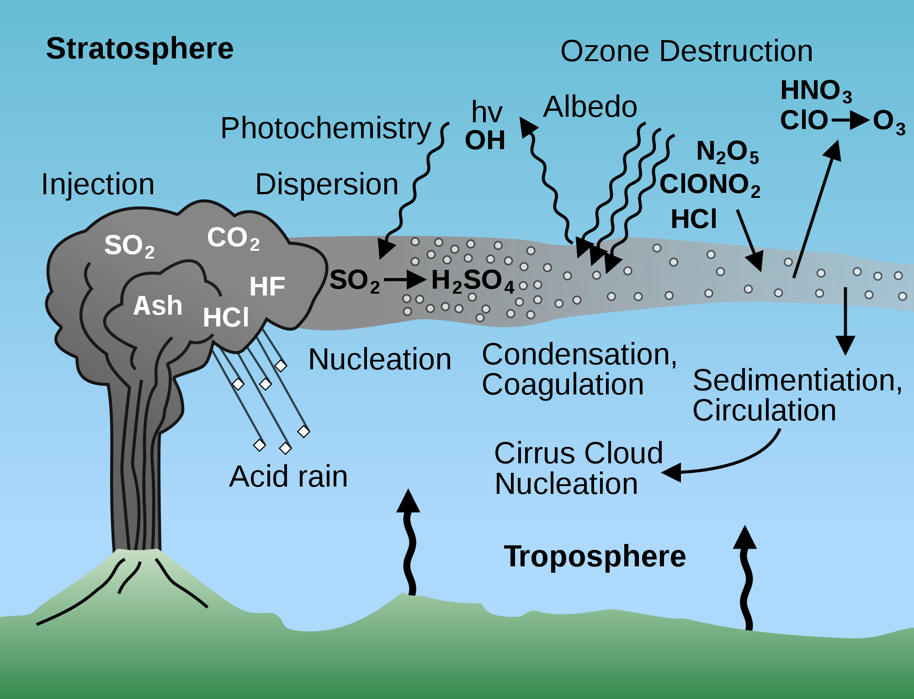

Slide 17
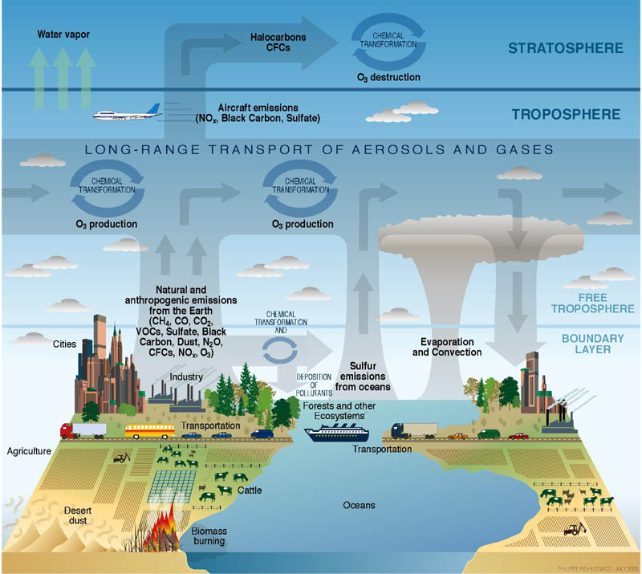

Slide 18
1) The ozone layer is contained within the stratosphere.
2) In this layer ozone concentrations are about 2 to 8 parts per million, which is much higher than in the lower atmosphere but still very small compared to the main components of the atmosphere.
3) It is mainly located in the lower portion of the stratosphere from about 15–35 km (9.3–22 mi; 49,000–110,000 ft), though the thickness varies seasonally and geographically.
4) About 90% of the ozone in our atmosphere is contained in the stratosphere.

Slide 19
Mesosphere
1) The mesosphere extends from the stratopause at about 50 km (31 mi; 160,000 ft) to 80–85 km (50–53 mi; 260,000–280,000 ft).
2) Temperature decreases with height in the mesosphere. The mesopause, the temperature minimum that marks the top of the mesosphere, is the coldest place on Earth and has an average temperature around −85 °C (−120 °F; 190 K).
3) At the mesopause, temperatures may drop to −100 °C (−150 °F; 170 K).[7] Due to the cold temperature of the mesosphere, water vapor is frozen, occasionally forming polar-mesospheric ice clouds.

Slide 20
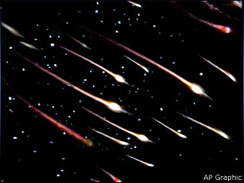
It is the layer where most meteors burn up upon entering the atmosphere.

Slide 21
Thermosphere
1) Temperature increases with height .
2) In the thermosphere the inversion is a result of the extremely low density of molecules. The temperature of this layer can rise to 1,500 °C (2,700 °F)
3) Though the gas molecules are so far apart that temperature in the usual sense is not well defined.
4) The International Space Station orbits in this layer, between 320 and 380 km (200 and 240 mi).
5) While the composition from the troposphere to the mesosphere is fairly constant, above a certain point, air is poorly mixed.
6) The top of the thermosphere is the bottom of the exosphere, called the exobase. Its height varies with solar activity and ranges from about 350–800 km (220–500 mi; 1,100,000–2,600,000 ft).[citation needed]

Slide 22
Exosphere
The exosphere is the outermost layer of Earth's atmosphere, extending beyond the exobase at an altitude of about 600 km.
2) It is mainly composed of hydrogen, helium and some heavier molecules such as nitrogen, oxygen and carbon dioxide closer to the exobase.
3) The atoms and molecules are so far apart that they can travel hundreds of kilometers without colliding with one another.

Slide 23
Be able to explain the interaction of
Incoming and outgoing radiation within
The troposphere and stratosphere;
“the Earth’s energy budget”
Why is the troposphere so important?
Explain weather and human activity.

Slide 24
STUDY QUESTION
Explain the decrease in temperature
That occurs in the Stratosphere?
The distance from the warming or radiating
Effect from the Earth surface and adiabatic
Cooling.
An adiabatic process is a process occurring without exchange of heat of a system with its environment.

Slide 25
Describe and give an explanation for the
Decrease in atmospheric pressure with
Increase in altitude.
Air pressure decreases from sea level
As altitude increases.
Atmospheric gases have particles that have
Mass and are affected by gravity.
A vertical pressure gradient is balanced
By the force of gravity.

Slide 26
The following gases make a contribution to the
Depletion of the Ozone layer and/or global
Warming;
CFC’S, Carbon Dioxide, Nitrogen Oxides,
Methane and water vapor.
Create a table showing which gases affect
the Ozone layer and cause Global warming
by a simple (YES) or (NO).

Slide 27
STUDY QUESTION
Explain two differences between the
processes that lead to Ozone depletion
and global warming.

Slide 28
EXPLANATION
GREENHOUSE GASES ACUMMILATE IN THE
TROPOSPHERE,
THESE GASES ABSORB RADIATED LONG WAVE
ENERGY,
OZONE DEPLETION IS A CATAYTIC PROCESS,
OPERATING IN THE STRATOSPHERE INVOLVING
CHLORINE AND OZONE.

Slide 29
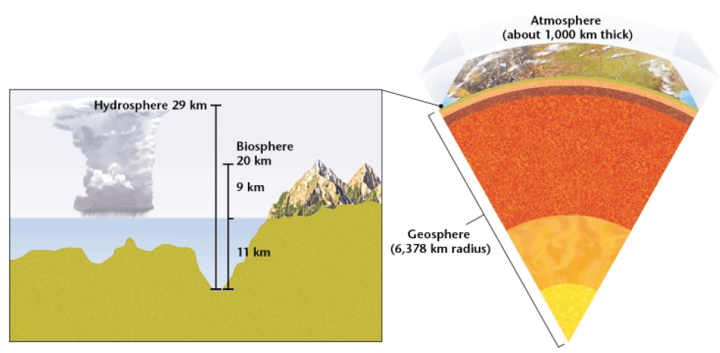
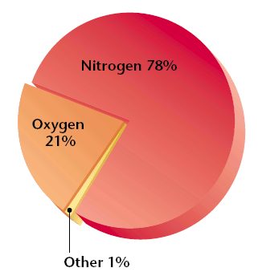
Decay of organic molecules from bodies and waste. (______cycle)
Source of atmospheric nitrogen: ____________
Which cycles maintain levels of H₂O, CO₂, O₂? ________________________
Water cycle & carbon cycle
Other: .9% Ar, .1% other (including water vapor)

Slide 30
Describe Each Atmospheric Layer
Composition
Temperature
Density variation
why temperature change in layers of atmosphere

Slide 31
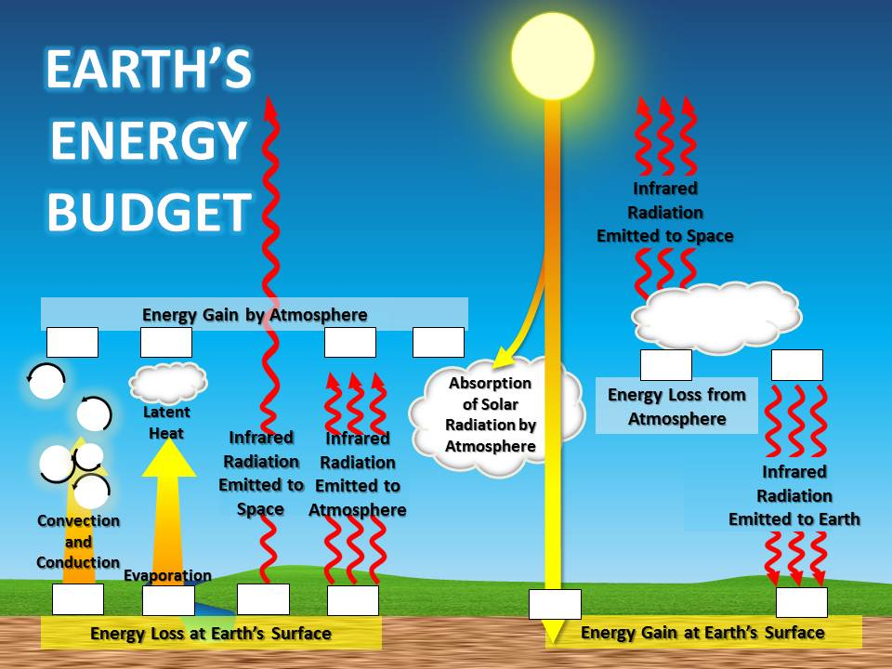

Slide 32
Earth’s Energy Budget

