Slide 1
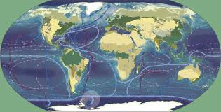
ATMOSPHERE
OBJECTIVE 2
WHAT IS THE PATTERN OF AIR MOVEMENT
IN THE TROPOSPHERE AND HOW DOES IT
INFLUENCE REGIONAL CLIMATES AND
LOCAL WEATHER?
WHAT METHODS ARE EMPLOYED TO
FORECAST WEATHER PATTERNS.

Slide 2
Troposphere’s Pattern of Air Movement & Its Influence on Regional Climates & Local Weather
Difference between climate & weather
Factors that influence weather
Global insolation
High & low pressure
Global & local wind systems
Effect of land, relief & ocean currents
Formation & characteristics of anticyclones, temperate frontal depressions, and tropical cyclones
Weather forecasting

Slide 3
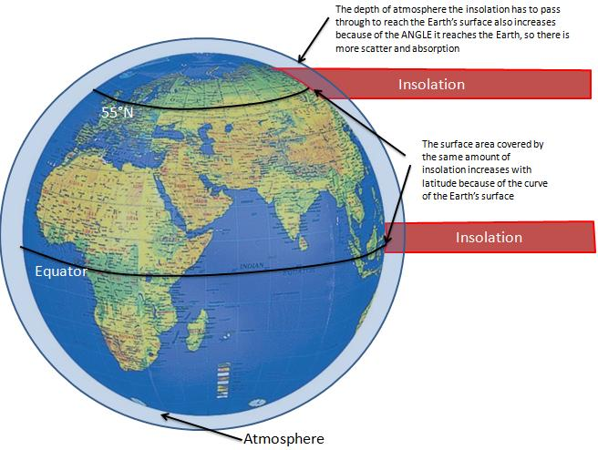
Insolation is a measure of solar radiation energy received on a given surface area and recorded during a given time.

Slide 4
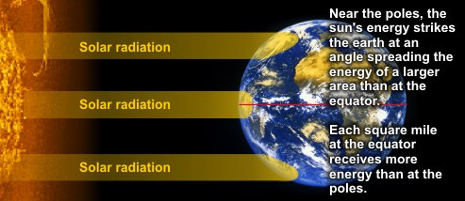

Slide 5
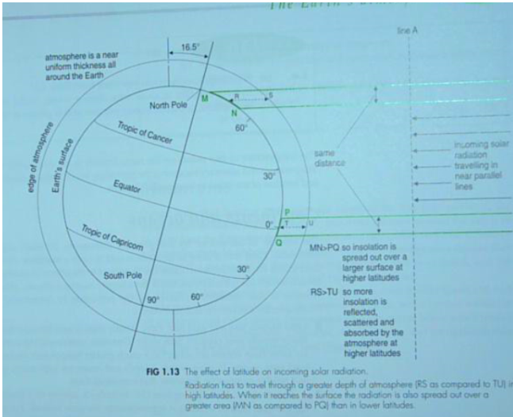
Latitude
http://wps.prenhall.com/esm_lutgens_atmosphere_10/48/12402/3174913.cw/index.html

Slide 6
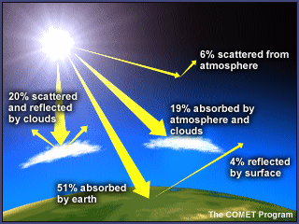

Slide 7
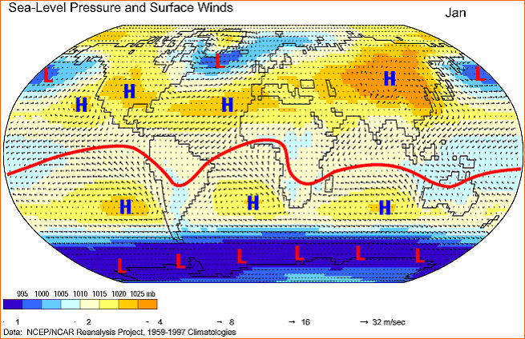
REGIONS OF HIGH AND LOW PRESSURE

Slide 8
Difference Between Climate & Weather
Weather is…
Climate is…

Slide 9
Factors That Influence Weather
Atmosphere: greenhouse effect, latent heat due to water phase changes, water cycle, winds, air mass collisions
Latitude: Direct rays vs. oblique rays, snow creates albedo area
Topography:
Uneven surface ultimately causes winds
rain falls on mountain sides closer to oceans
Water’s heat carrying capacity: range of temperature different for coastal vs. inland at same latitude,
Human Influence: ∆ in topography → less trees → less oxygen, water & more CO₂; Burning fuels → adds green house gases to atmosphere, puts particulates in atmosphere

Slide 10
Interrelation Between Water Cycle & the Atmosphere
Cloud condensation nuclei
Natural: Dust storms, volcanic eruptions, pollen, sea salt, respiration, combustion particles (fire)
Anthropogenic: combustion particles
Clouds (water vapor) absorb infrared radiation
Thick clouds reflect solar radiation (albedo)
Evaporation cools surfaces (latent heat of vaporization) heat is absorbed by water molecules
Latent heat of condensation

Slide 11
Cloud & Precipitation Formation
Dew point
Why?
Adiabatic temperature changes – expands – cools; compresses - warms

Slide 12
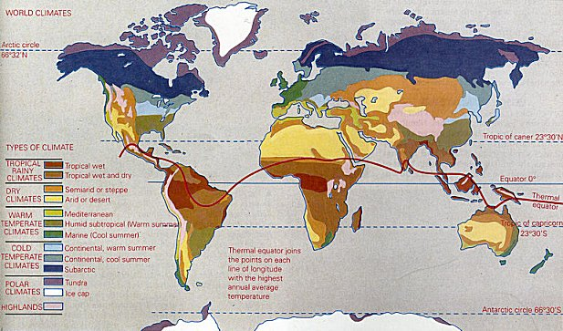

Slide 13
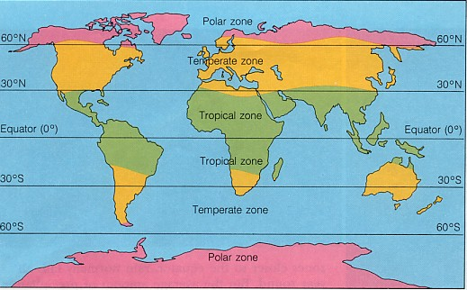

Slide 14
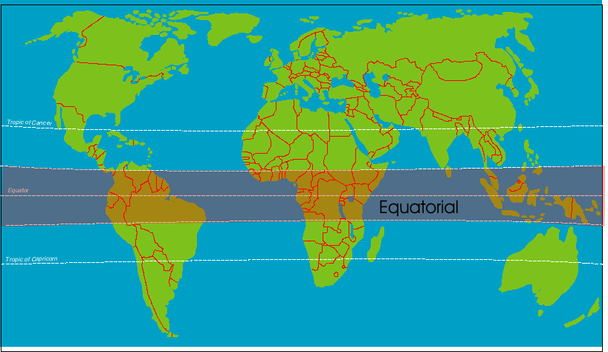

Slide 15
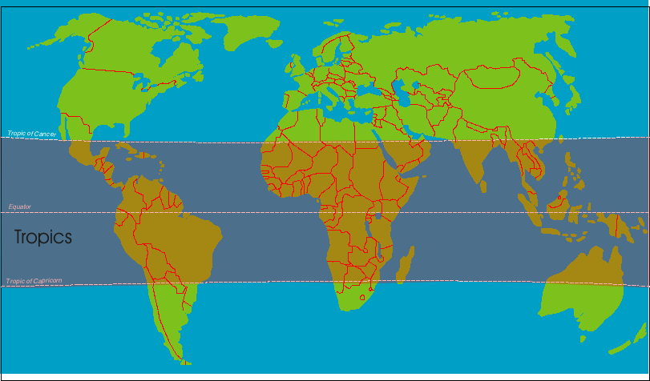

Slide 16
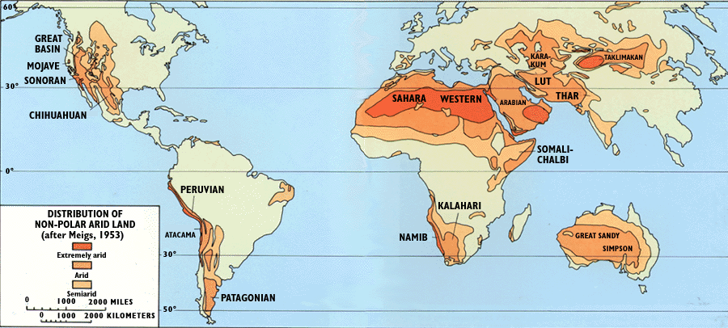
deserts

Slide 17
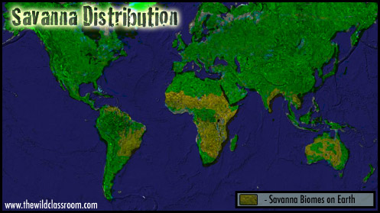

Slide 18
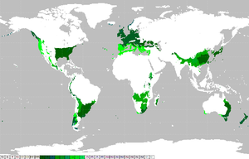
Warm temperate climate

Slide 19
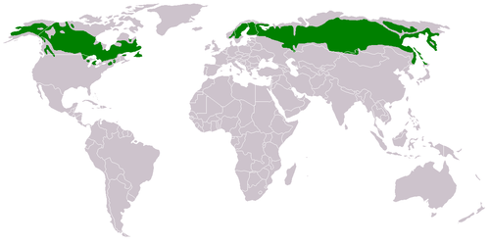
Sub-arctics

Slide 20
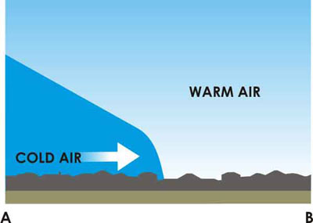
A frontal depression is a low pressure centre with two frontal sur- faces, a cold frontal surface to the left and a warm frontal surface to the right (in the northern hemisphere). Between the two frontal surfaces lies the warm sector, which is an air flow of tropical air masses. To the left and right of the frontal surfaces there is an air flow of cold polar air masses.

Slide 21
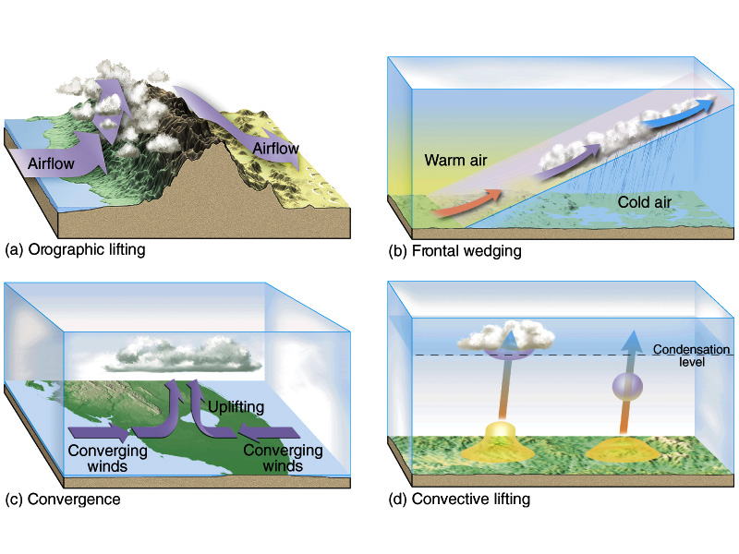
Four lifting processes
Windward side
Leeward side

Slide 22
Global & Local Wind Systems
Wind – caused by differences in horizontal air pressure (High to low)
Uneven heating of earth’s surface creates pressure differences
Solar energy basis of wind energy
Wind controlled by
Pressure-gradient force
Coriolis force
Friction

Slide 23
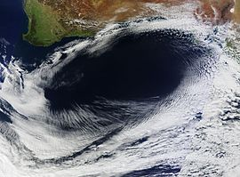
An anticyclone (that is, opposite to a cyclone) is a weather phenomenon defined by the United States' National Weather Service's glossary as "[a] large-scale circulation of winds around a central region of high atmospheric pressure, clockwise in the Northern Hemisphere, counterclockwise in the Southern Hemisphere"

Slide 24
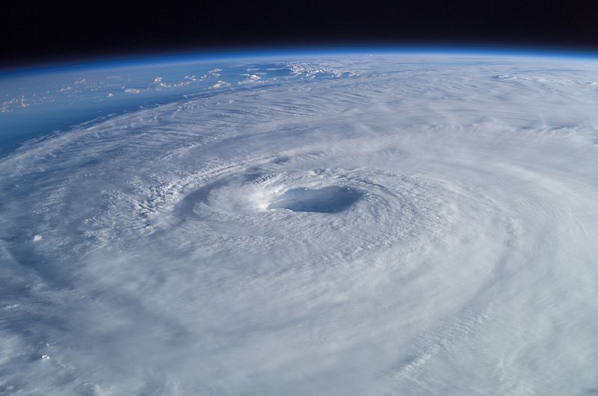
tropical cyclone is a rapidly-rotating storm system characterized by a low-pressure center, strong winds, and a spiral arrangement of thunderstorms that produce heavy rain.
Tropical cyclones typically form over large bodies of relatively warm water. They derive their energy from the evaporation of water from the ocean surface
Depending on its location and strength, a tropical cyclone is referred to by names such as hurricane or typhoon, tropical storm, cyclonic storm, tropical depression, and simply cyclone.

Slide 25
2. Describe the usefulness of the data in for forecasting future tropical cyclones. Outline two additional sources of information that could be used to make accurate tropical cyclone forecasts.

Slide 26
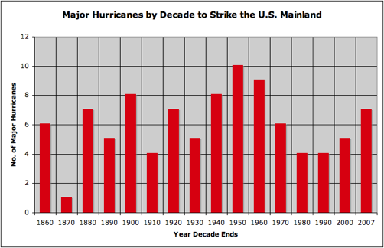

Slide 27
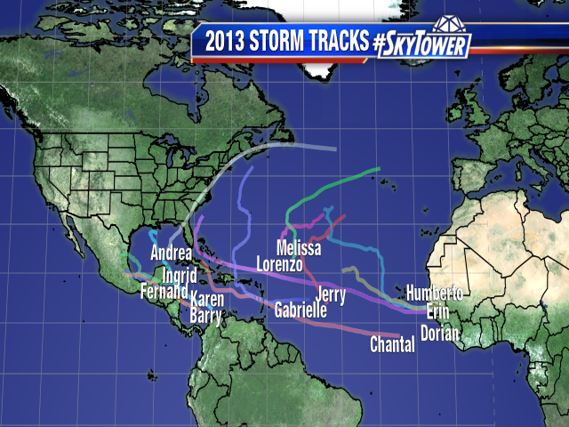
historical data.
radar tracking / satellite imagery
ocean temperature
air pressure monitoring
Climatic conditions data
weather forecasting
linking size to likely destructiveness
sending monitoring equipment into the storm

Slide 28
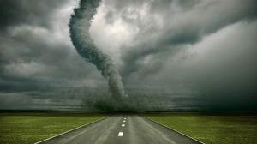
A warm front is warm air displacing cool air diagram. Shallow leading edge warm air must "overrun" cold air--cold air recedes moves slow 10-15 knts
A stationary front is characterized by no movement of the transition zone between two air masses.
A cold front is cold air displacing warm air.
There are two kinds of occluded fronts:
1.Cold occlusion-cold front catches up with warm front.
2.Warm occlusion mostly in NW. Warm or cool air off the ocean

Slide 29
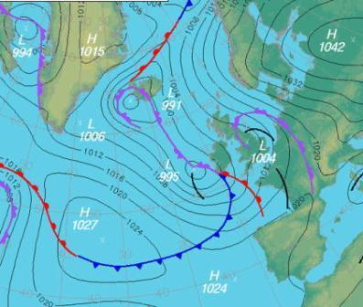
AICE QUESTION: 1) INTERPRET THE WEATHER MAP

Slide 30
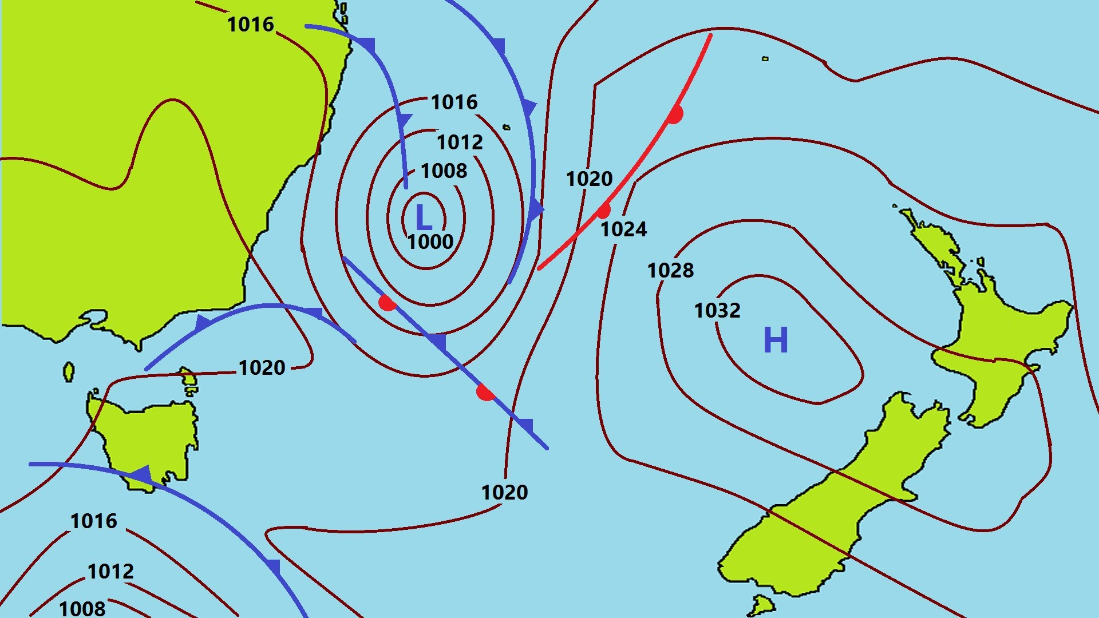
Maritime versus continental climate.
2. Different thermal properties of land / sea (sea has a higher specific heat capacity).
3. Insolation penetrates deep below water surface, shallow depth on land.
4. Mixing of ocean waters moderates winter temperatures
. 5.Presence of warm current in North Atlantic / gulf stream.
6.The role of different air masses.
7.Cloud cover over ocean a moderating influence on winter temperatures.

Slide 31
High & Low Pressure
Air pressure – force (Newtons) against a surface due to constant collision of gas molecules. 1 millibar = 1000 N.
Horizontal air pressure compensated to be sea level due to altitudinal differences
Cold air is ______ dense→ ____ pressure: Called _____
Warm air is ______ dense→ ____ pressure: Called ____
Water vapor actually reduces density.

Slide 32
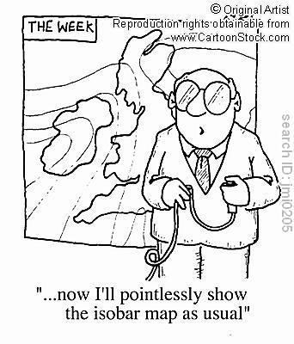
Pressure-gradient force
Isobars
Closely spaced – strong pressure gradient with high wind speeds
High speeds generally around Lows

Slide 33
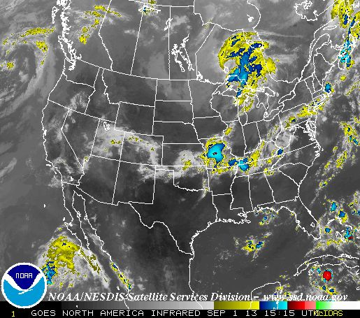

Slide 34
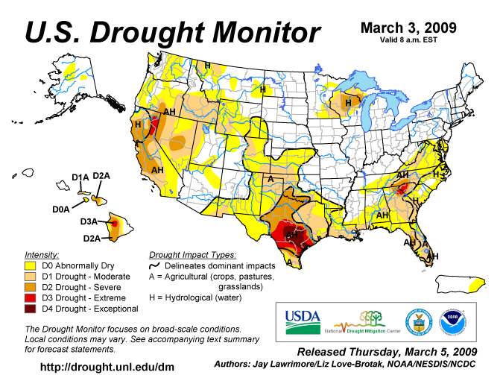
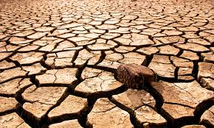

Slide 35
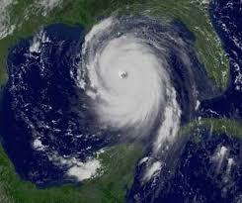
Homework!
3. STUDENTS WILL DOWNLOAD A RELEVANT
CASE STUDY OF A HURRICANE(i.e. KATRINA,
SANDY, ANDREW) AND A DROUGHT( i.e. TEXAS,
INDIA,GEORGIA, CALIFORNIA)
http:
htt
EACH STUDENT SHOULD BE ABLE TO WRITE
ABOUT A CASE STUDY TO FULFILL AICE
CURRICULUM.

Slide 36
Coriolis Effect on Horizontal Direction
Coriolis effect: deflection in northern hemisphere is to _____________; southern hemisphere is to _________
Degree of deflection due to Coriolis forces are stronger at higher latitudes and stronger winds.

Slide 37
The Different Forces That Effect Winds
P-G force causes winds to move perpendicular to isobars
Aloft air = Less friction
Wind speeds increase until Coriolis force = pressure-gradient force (geostrophic balance)
Ultimately, winds travel parallel to isobars (geostrophic wind)
Steep pressure gradient = strong winds
IDEALIZED situation

Slide 38
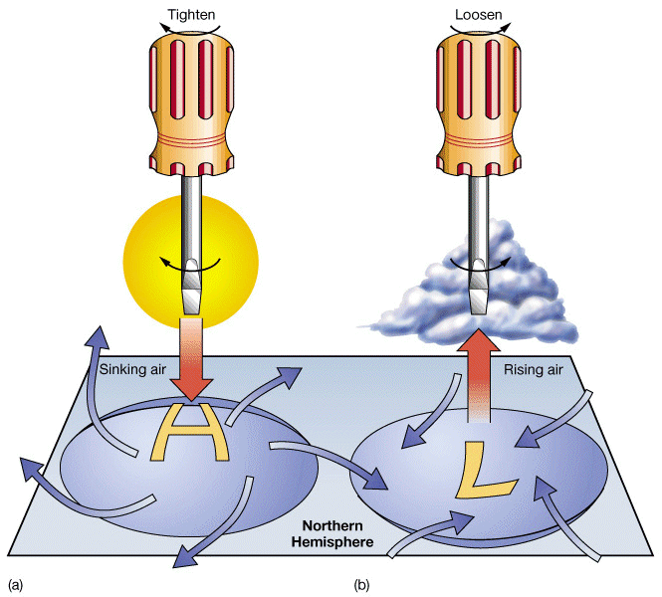
Link

Slide 39
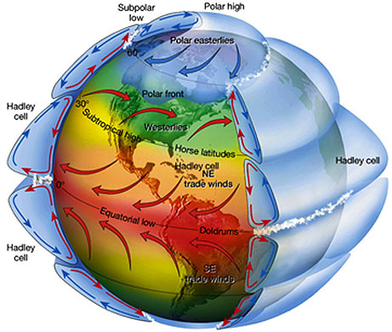

Slide 40
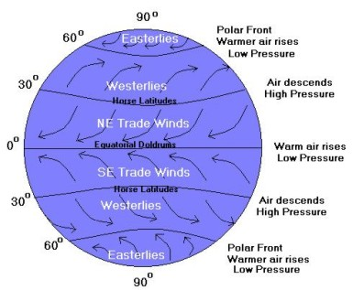

Slide 41
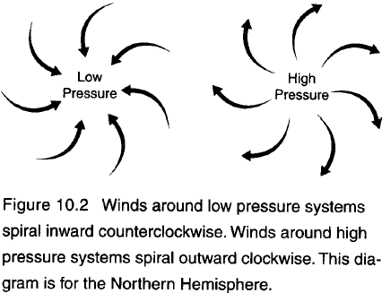

Slide 42
Isobars & wind speeds
Can you figure out / remember the relationship between isobars & wind speed?

Slide 43
Circular isobars means winds follow circular path to be parallel to isobars
Notice direction of L and H pressure system in Northern Hemisphere
Recall Device time: Cyclone – Low Pressure center, winds travel to left (same as Earth’s rotation CCW), isobar trough

Slide 44
Friction’s Effect
P-G force causes wind to move . . .
Coriolis force balances wind to move . . .
Frictional force causes wind to move . . .

Slide 45
Notice the direction of wind of the two pressure systems.

Slide 46
Isobars with Fronts
Which direction is the wind blowing?
Why is the cold front “chasing” the warm front?
Is this hurricane status? How do you know?
What kind of weather is the DC area experiencing?
What kind of weather is TN experiencing?

Slide 47
Vertical Airflow for Cyclones & Anticyclones
Low pressure wind pattern at the surface
Causes net upward motion of ~ 1km/day. Thunderstorm updrafts >100 km / hr
causes cloud formation
Low pressure center pushes air up, like converging tectonic plates with similar density.

Slide 48
Isobars are parallel – same pressure, same temperature
Land warms faster than water, so the continental air is warming, and therefore rising. As the air rises, it expands & cools adiabatically, thus creating the high over the land. (Creates divergence aloft)
Convergence occurs aloft over the ocean – the air piles up and becomes a heavier column which is pushed to the surface of the ocean, creating a High.

Slide 49
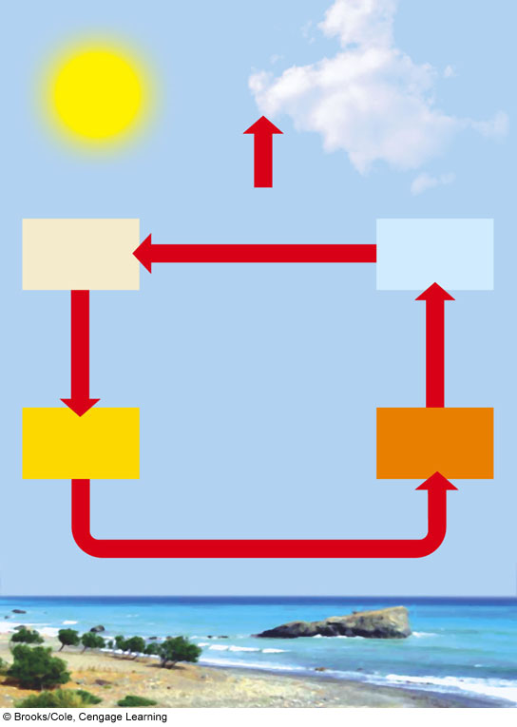
In other words…
LOW PRESSURE
HIGH PRESSURE
Heat released radiates to space
Cool, dry air
Condensation and precipitation
Falls, is compressed, warms
Rises, expands, cools
Warm, dry air
Hot, wet air
Flows toward low pressure, picks up moisture and heat
HIGH PRESSURE
Moist surface warmed by sun
LOW PRESSURE
Fig. 7-4, p. 143
Notes:
Figure 7.4
Energy transfer by convection in the atmosphere. Convection occurs when hot and wet warm air rises, cools, and releases heat and moisture as precipitation (right side). Then the denser cool, dry air sinks, gets warmer, and picks up moisture as it flows across the earth’s surface to begin the cycle again.

Slide 50
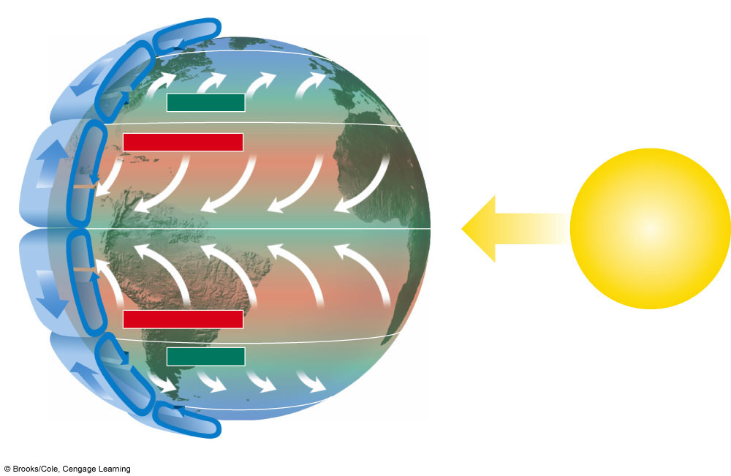
Global Air Circulation
Cold deserts
60°N
Air cools and descends at lower latitudes.
Westerlies
Forests
30°N
Hot deserts
Northeast trades
Warm air rises and moves toward the poles.
Forests
0°
Solar energy
Equator
Air cools and descends at lower latitudes.
Southeast trades
Hot deserts
30°S
The highest solar energy input is at the equator.
Westerlies
Forests
Cold deserts
60°S
Fig. 7-3, p. 142
Notes:
Figure 7.3
Global air circulation. The largest input of solar energy occurs at the equator. As this air is heated it rises and moves toward the poles. However, the earth’s rotation deflects the movement of the air over different parts of the earth. This creates global patterns of prevailing winds that help distribute heat and moisture in the atmosphere.

Slide 51
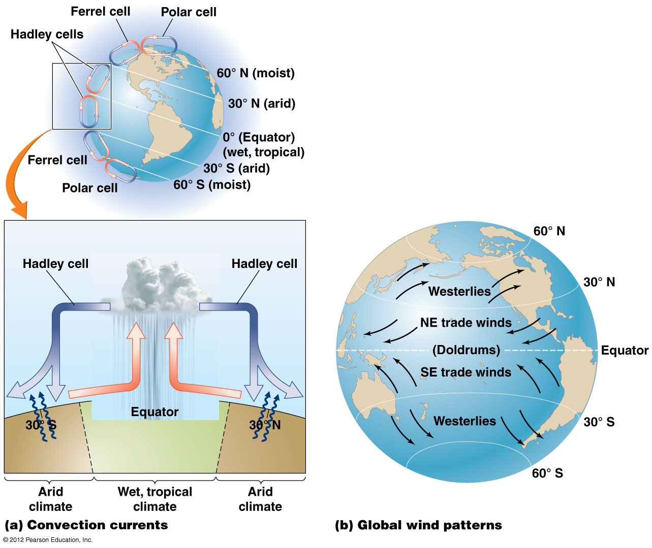
Climate patterns and moisture distribution

Slide 52
Storms pose hazards
Atmospheric conditions can produce dangerous storms
Hurricanes (typhoons, cyclones): form when winds rush into areas of low pressure
Warm, moist air over the topical oceans rises
Drawing up huge amounts of water vapor
Which falls as heavy rains
Tornadoes: form when warm air meets cold air
Quickly rising warm air forms a powerful convective current (spinning funnel)

Slide 53
We need to understand the atmosphere
Understanding how the atmosphere works helps us to:
Predict violent storms and protect people
Comprehend how pollution affects climate, ecosystems, economies, and human health

