Slide 1
OBJECTIVE 4
ESSENTIAL QUESTION
WHAT HAS BEEN THE IMPACT OF POPULATION
GROWTH UPON THE RESOURCES OF COUNTRIES
AT CONTRASTING LEVELS OF ECONOMIC
DEVELOPMENT ?

Slide 2
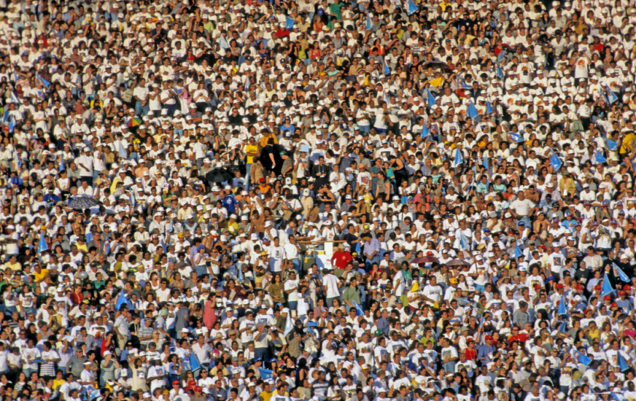
A population is a summation of all the organisms of the same group or species, who live in the same geographical area, and have the capability of interbreeding.
As of July 2013, it is estimated to number 7.151 billion by the United States Census Bureau

Slide 3
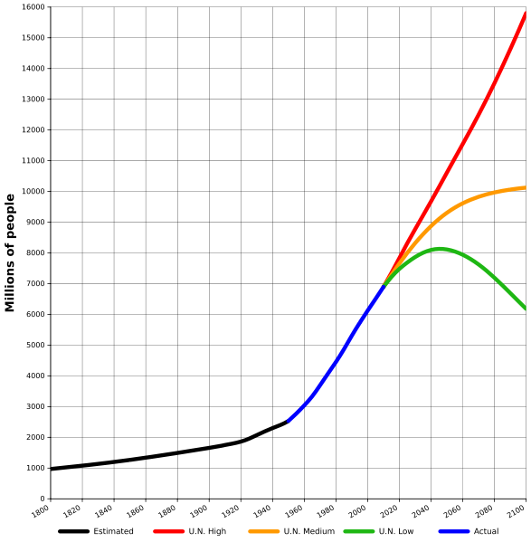

Slide 4
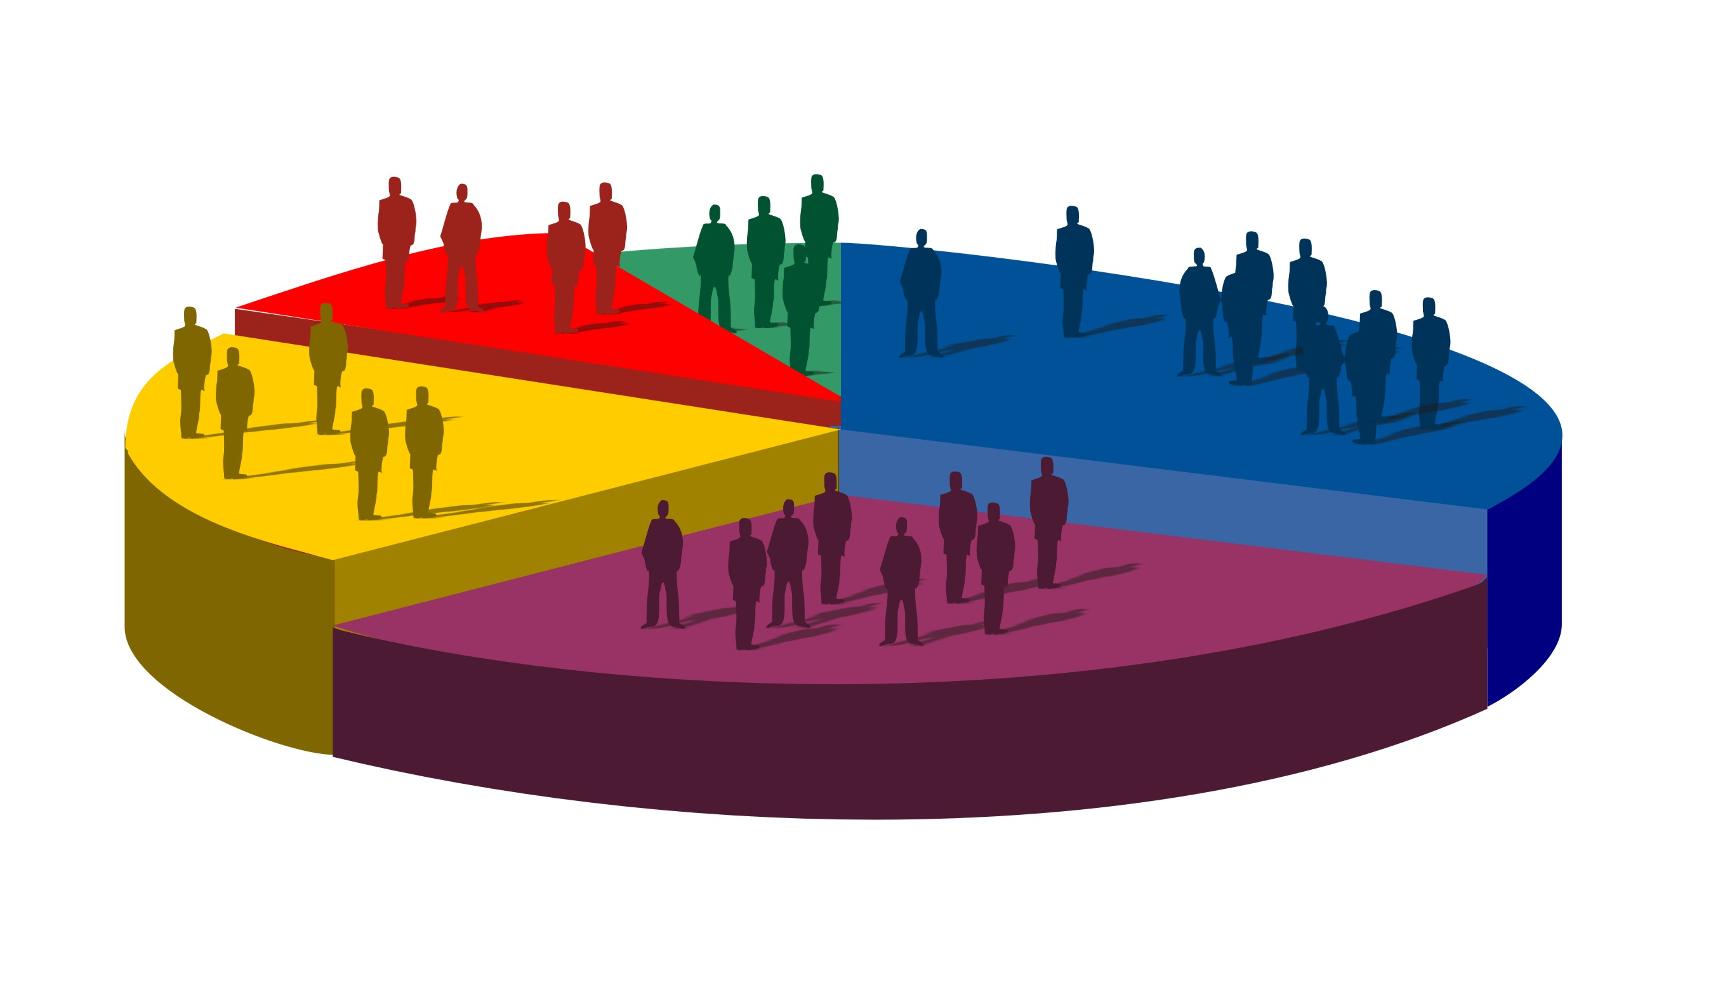
Population Dynamics and Carrying Capacity
Population size is governed by births, deaths, immigration, and emigration:
[Population Change] = [Births + Immigration] – [Deaths + Emigration)

Slide 5
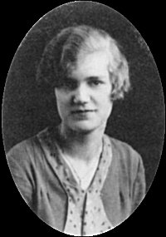
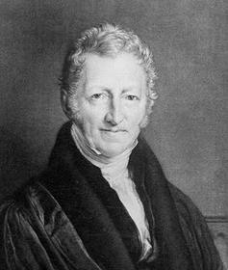
Ester Boserup (1910-1999)
Thomas Malthus (1766-1834)
www.livingston.org/
Population determines
agricultural methods.
The rate of the population's growth increase faster than the rate of the food supply which later cause problems such as poverty and famine.
"The power of ingenuity would always outmatch that of demand"

Slide 6
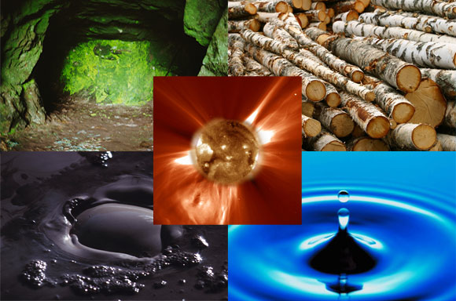
HUMANS AND RESOURCES
BIOZONE TEXT
PAGE 96
1-2

Slide 7
Overpopulation
Overpopulation is a function of the number of individuals compared to the relevant resources, such as the water and essential nutrients they need to survive. It can result from an increase in births, a decline in mortality rates, an increase in immigration, or an unsustainable biome and depletion of resources.

Slide 8
under population
An insufficient number of residents compared to the number who could live in a given area and maintain a given plane of living.

Slide 9
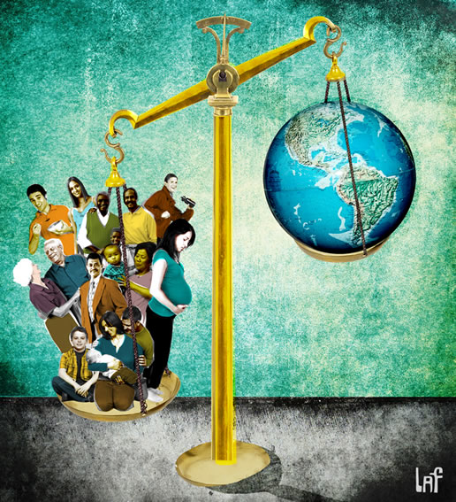
optimum population
The optimum population is the size of a population that is the best out of several outcomes.

Slide 10
POLICIES AIMED AT RESOLVING POPULATION
ISSUES INCLUDE:
SUSTAINABLE AND MORE PRODUCTIVE
FARMING METHODS IN LEDCs AND MEDCs.
2. ECONOMIC AND SOCIAL DEVELOPMENT
3. THE SUSTAINABLE PROVISIONS OF ENERGY
AND INDUSTRIAL RAW MATERIALS

Slide 11
a large increase in crop production in developing countries achieved by the use of fertilizers, pesticides, and high-yield crop varieties.

Slide 12
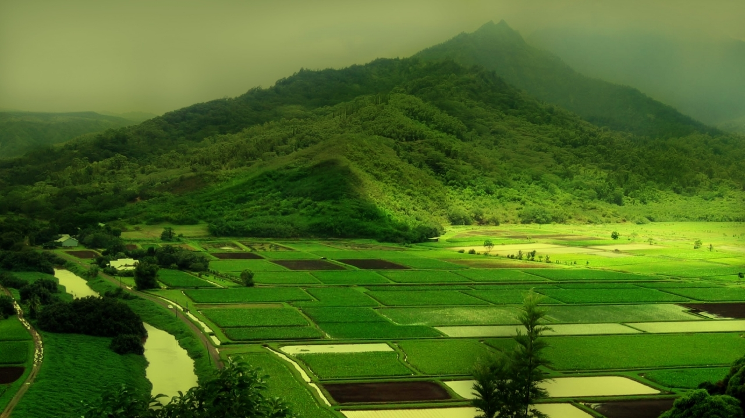
Green Revolution refers to a series of research, development, and technology transfer initiatives, occurring between the 1940s and the late 1960s, that increased agriculture production worldwide, particularly in the developing world, beginning most markedly in the late 1960s.
These technologies included modern irrigation projects, pesticides, synthetic nitrogen fertilizer and improved crop varieties developed through the conventional, science-based methods available at the time.

Slide 13
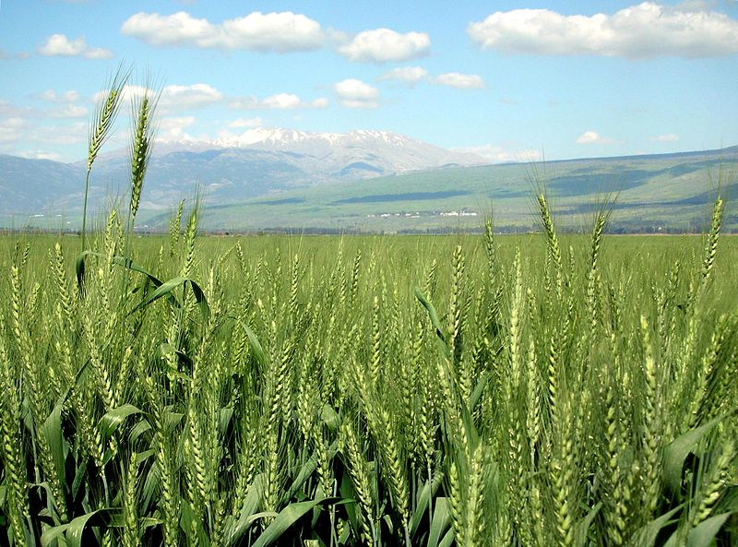
Cereal production more than doubled in developing nations between the years 1961–1985. Yields of rice, maize, and wheat increased steadily during that period.
Environmental impact
reduce agricultural biodiversity, as it relied on just a few high-yield varieties of each crop.
relies on extensive use of pesticides

Slide 14
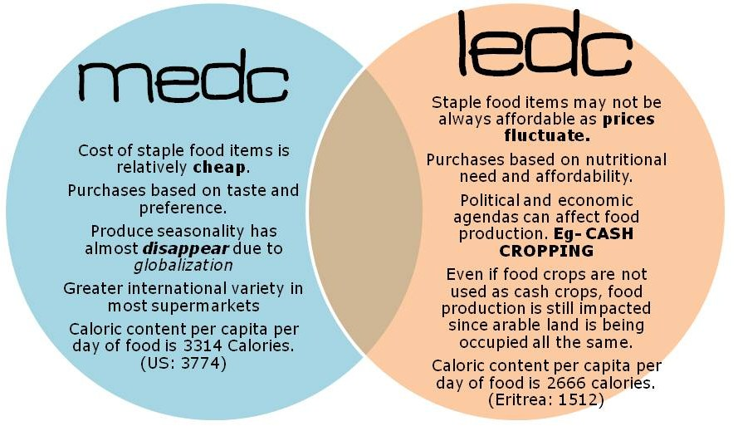

Slide 15
