Slide 1
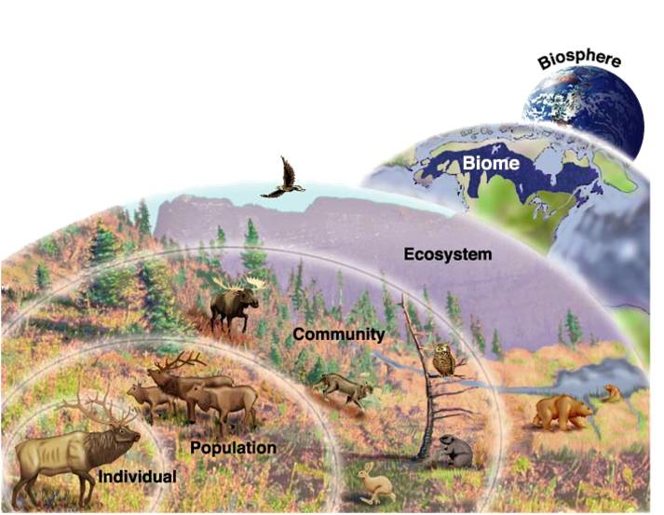
BIOSPHERE

Slide 2
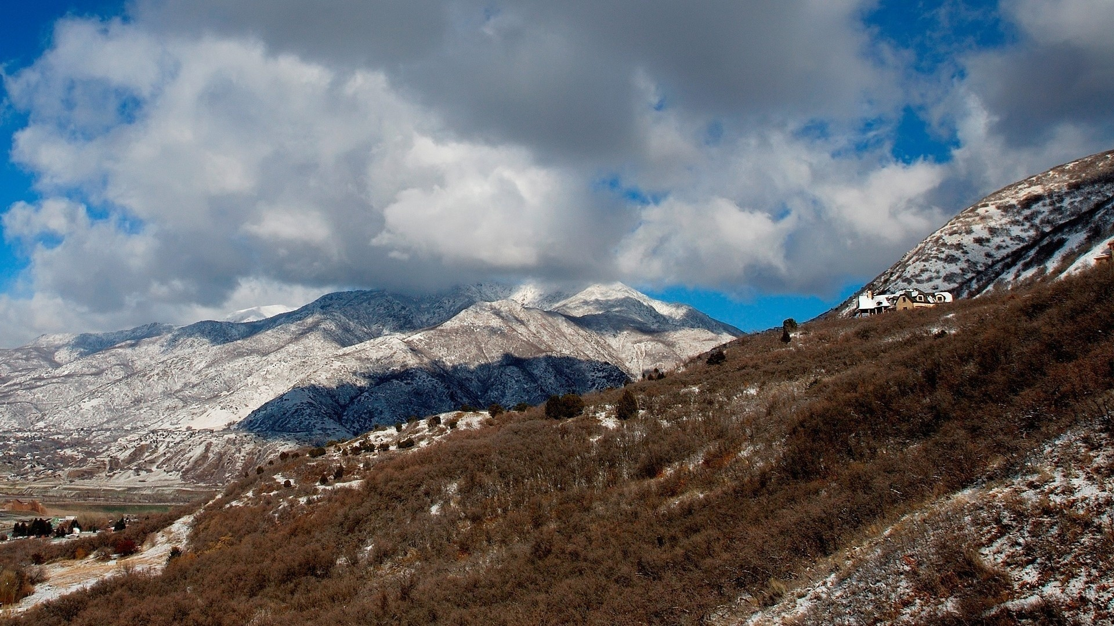
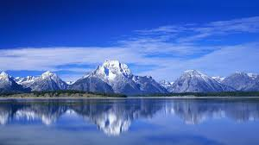
OBJECTIVE 1
ESSENTIAL QUESTION
WHAT ARE THE MAJOR ABIOTIC AND BIOTIC
FACTORS, WHICH DRIVE AND INFLUENCE THE
DISTRIBUTION OF DIFFERENT ECOSYSTEMS?
WHAT ARE THE MAIN COMPONENTS AND
CHARACTERISTICS OF ECOSYSTEMS AND HOW
ARE THEY STRUCTURED?

Slide 5
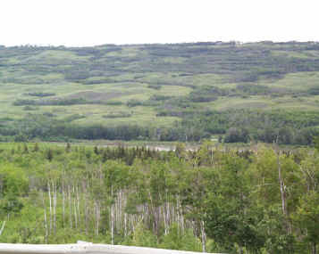
SOIL
TEMPERATURE
RAINFALL
PHOTOSYNTHESIS
NET PRIMARY PRODUCTIVITY
THE CHARACTERISTICS OF ECOSYSTEMS
IN TERMS OF THEIR BIOTIC AND ABIOTIC
COMPONENTS
SUCCESSION
BIOMASS
BOIDIVERSITY
TROPHIC LEVELS
FOOD WEBS AND CHAINS
HABITATS
NICHE

Slide 6
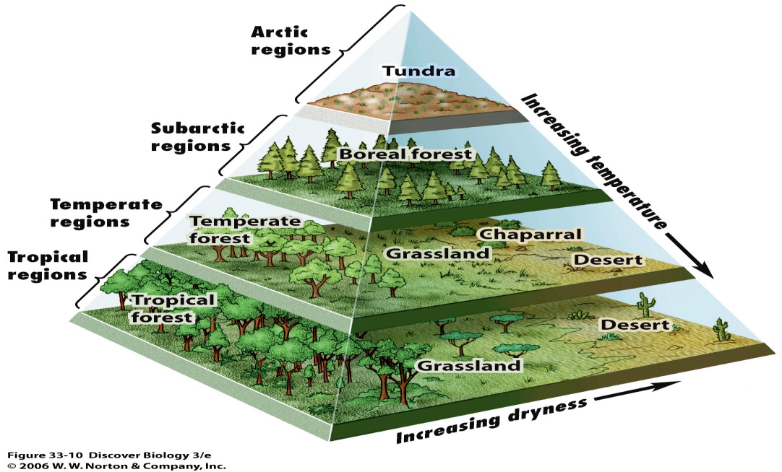
THE INTERSECTION OF THESE COMPONENTS IS
ILLUSTRATED THROUGH :
2. STORES OF NUTRIENTS
BETWEEN VEGETATION.
RELATIVE SIZE
OR AMOUNT OF ENERGY
FLOW.
3. SOIL OR
LITTER.

Slide 7
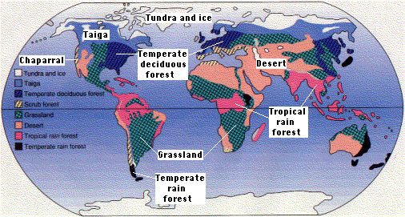

Slide 8
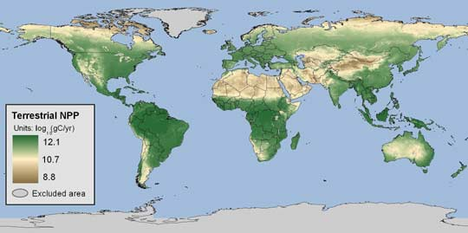
ECOSYSTEMS OCCUR ON A VARIETY OF SCALES WITHIN
A BROAD VEGETATION ZONES.
THE INFLUENCE OF LIGHT INTENSITY
AND RAINFALL ON PLANT PRODUCTIVITY.

